Slide 1
The Internet as a resource for knowledge and useful information

Slide 2
„The Internet can contribute to the education and the Global Connectivity of the young“

Slide 3
Heavy Legacy

Slide 5
Usage Today

Slide 6
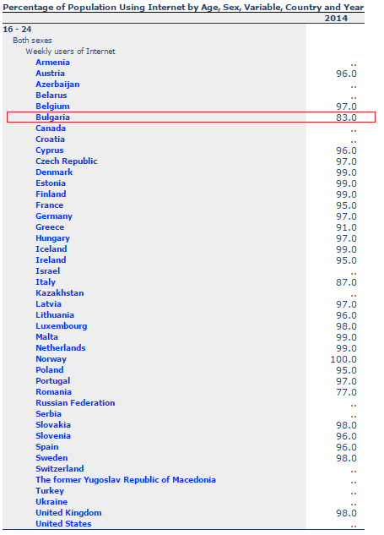

Slide 7
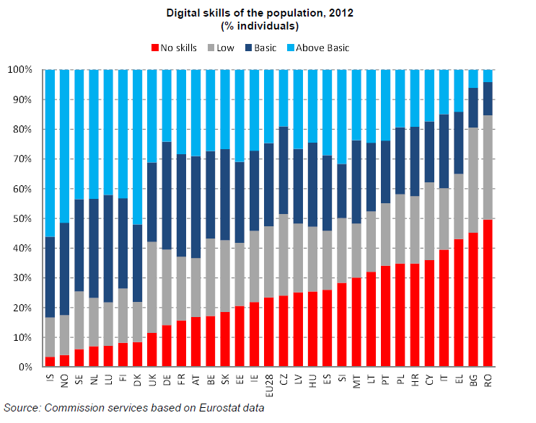

Slide 8
How confident are we in our skills?

Slide 10
What does Business require?

Slide 11
Reality 1

Slide 12
Reality 2

Slide 13
Reality 3

Slide 14
Reality 4

Slide 15
Responsibilities
Parents
Teachers
Society
Country

Slide 16
Proposals
The IT Business has to teach the teachers in schools
IT students to volunteer in schools
National information campaign for parents about the possibilities and the importance of digital skills of their children

Slide 17
Let’s End Up at an Optimistic Note ☺

