Slide 1

The Internet as a resource for knowledge and useful information

Slide 2
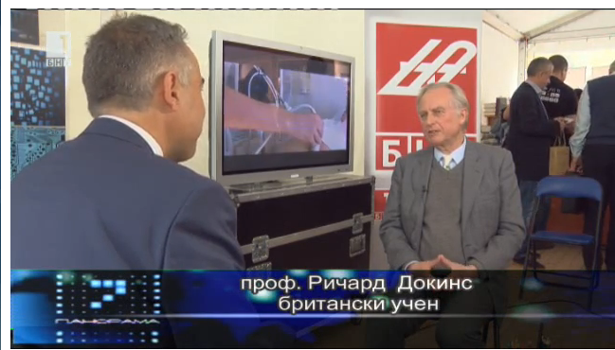
„The Internet can contribute to the education and the Global Connectivity of the young“

Slide 3
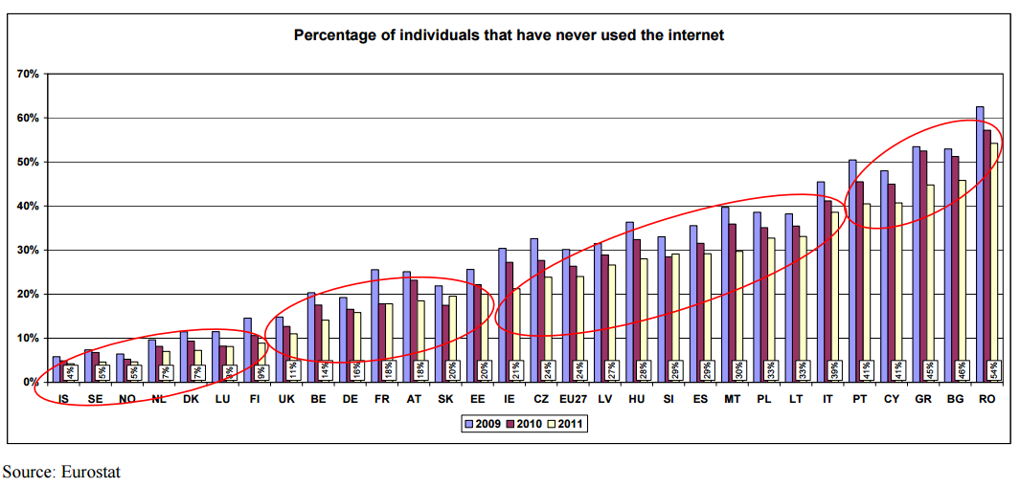
Heavy Legacy

Slide 4
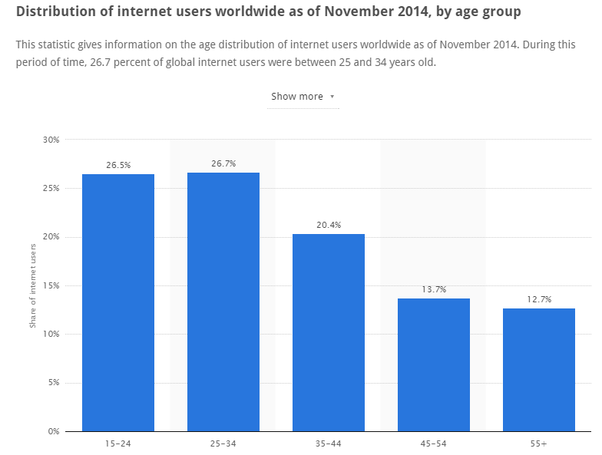

Slide 5
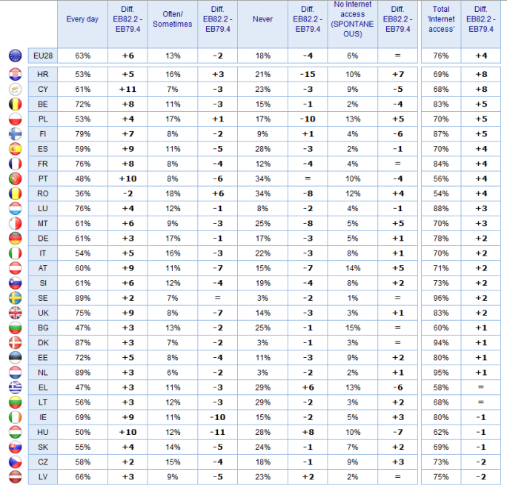
Usage Today

Slide 6
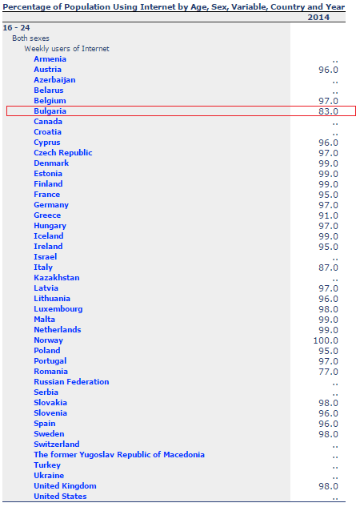

Slide 7
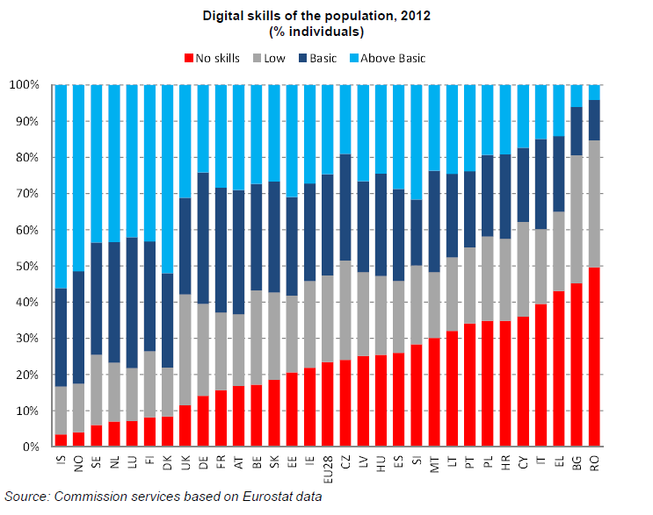

Slide 8
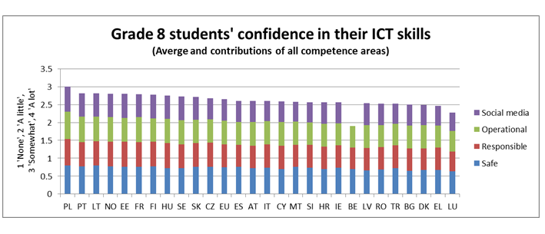
How confident are we in our skills?

Slide 9
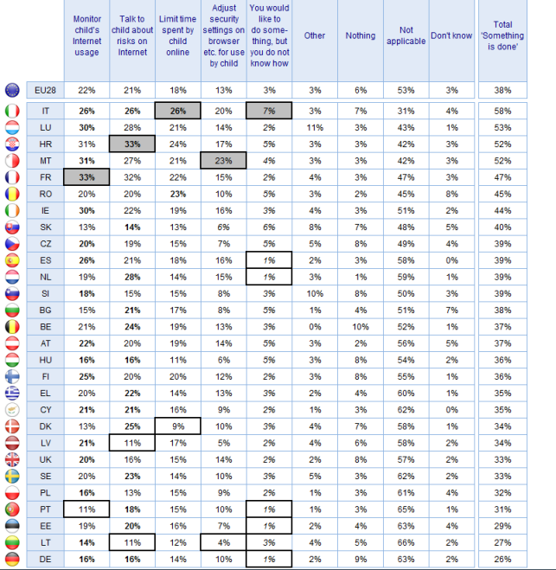

Slide 10
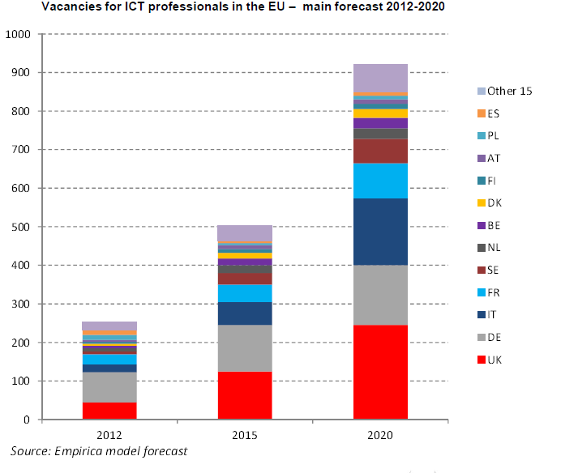
What does Business require?

Slide 11
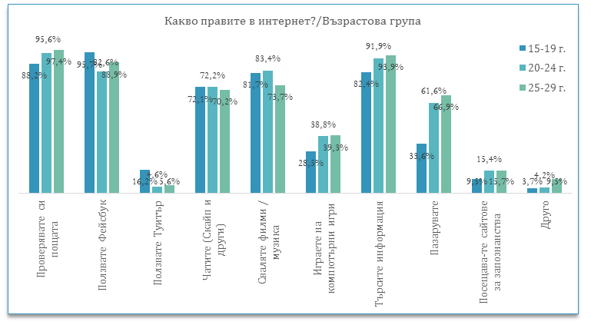
Reality 1

Slide 12
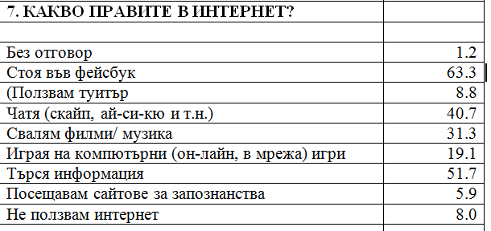
Reality 2

Slide 13
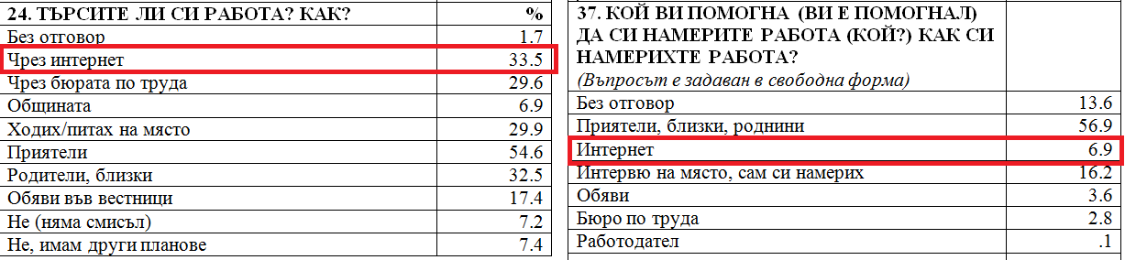
Reality 3

Slide 14
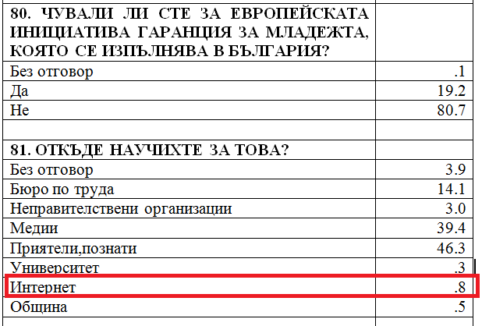
Reality 4

Slide 15
Responsibilities
Parents
Teachers
Society
Country

Slide 16
Proposals
The IT Business has to teach the teachers in schools
IT students to volunteer in schools
National information campaign for parents about the possibilities and the importance of digital skills of their children

Slide 17
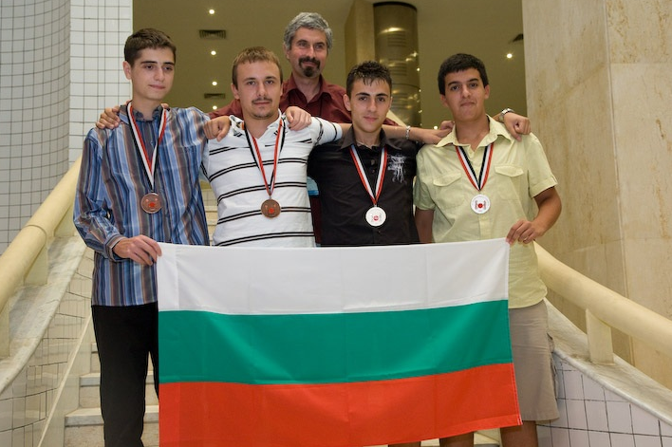
Let’s End Up at an Optimistic Note ☺

