Slide 1
SUPERPOWERS OF PROCUREMENT DATA
IMPORTANCE AND IMPACT OF OPENING DATA
Stiliyana Peneva – expert
Diman Stamatov – expert
Information Technology Directorate
Ministry of Transport, Information Technology and Communications – Bulgaria
30-31 May 2018
Brussels
Slide 1

Slide 2
SUPERPOWERS OF PROCUREMENT DATA
The Impact of Open Data in Developing Economies
Open Governance & Open Development
Flexibility
Participation
Trust
Equality
Security
Value amplifier
Open Source
Open Innovation
30-31 May 2018
Brussels
Slide 2

Slide 3
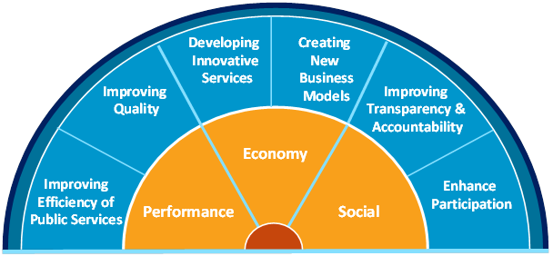
SUPERPOWERS OF PROCUREMENT DATA
Benefits
Source - http://www.opendata.ngolinks.eu/13/page.html
Source – European Data Portal
30-31 May 2018
Brussels
Slide 3

Slide 4
SUPERPOWERS OF PROCUREMENT DATA
Impact of Open Data
Improving Governance
Empowering Citizens
Creating Economic Growth
Solving Public Problems
30-31 May 2018
Brussels
Slide 4

Slide 5
SUPERPOWERS OF PROCUREMENT DATA
Projected open data market size
Billions
Millions
30-31 May 2018
Brussels
Slide 5

Slide 6
SUPERPOWERS OF PROCUREMENT DATA
Economic benefits
325 billion Euro direct market size for the 2016 - 2020 period 36.9% increase in share of GDP from 2016 to 2020 83,578 million Euro market for public adminsitration in 2020
100,000 jobs in Open data in 2020 7.3% average increase in Open Data jobs More than 2,500 jobs in at least nine countries
1.7 billion Euro cost savings for EU28+ public administration in 2020
7,000 lives can be saved due to quicker response 2,549 hours can be saved in terms of finding parking 629 million hours saved, equivalent to 27.9 billion Euro
30-31 May 2018
Brussels
Slide 6

Slide 7
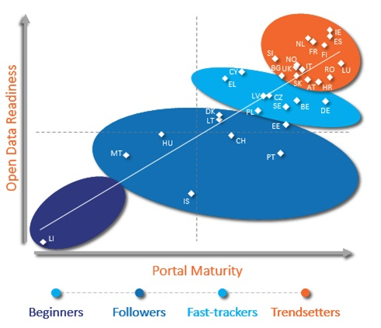
SUPERPOWERS OF PROCUREMENT DATA
The situation back home
Source: The Digital Economy and Society Index (European Commission)
Dataset
Breakdown
Score
Procurement
Source: Global open data index
Source: European data portal
30-31 May 2018
Brussels
Slide 7

Slide 8
SUPERPOWERS OF PROCUREMENT DATA
Case study - health and open data in Uruguay
30-31 May 2018
Brussels
Slide 8

Slide 9
SUPERPOWERS OF PROCUREMENT DATA
Case study - Open Contracting And Procurement In Slovakia
30-31 May 2018
Brussels
Slide 9

Slide 10
SUPERPOWERS OF PROCUREMENT DATA
CHALLENGES
Open Data
Awareness
Organizational
Technical
Political
Financial
Legal
30-31 May 2018
Brussels
Slide 10

Slide 11
SUPERPOWERS OF PROCUREMENT DATA
THANK YOU
Stiliyana Peneva: speneva@mtitc.government.bg
Diman Stamatov: dstamatov@mtitc.government.bg
Information Technology Directorate
30-31 May 2018
Brussels
Slide 11

