Slide 1
BULGARIA AND THE WESTERN BALKANS: TRANSPORT CONNECTIVITY
Ministry of Transport, Information Technology and Communications
Ivaylo Moskovski
Minister of Transport, Information Technology and Communications
17 May 2018

Slide 2
Transport connectivity in the region
An essential instrument for the competitiveness of regions in a globalized economy
Facilitates trade flows and tourism
Contributes to the economic growth of the regions
Strong enabler of people-to-people relations
EU - SEE Connectivity Legal Framework
  Western Balkans Strategy adopted on 6th February 2018
  Western Balkans Transport Community Treaty signed on 12th July 2017

Slide 3
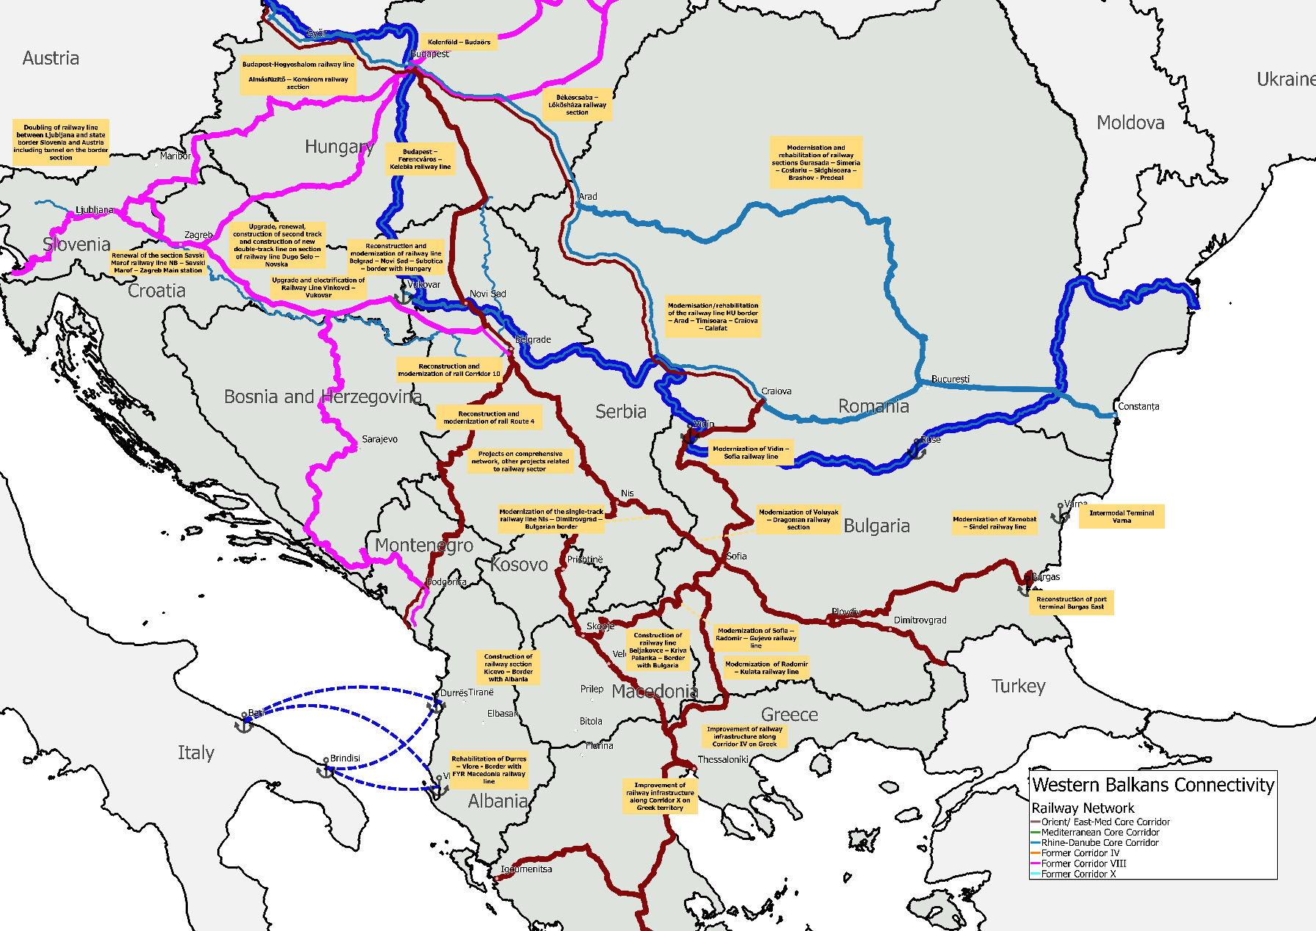
Transport connectivity in the region (2)

Slide 4
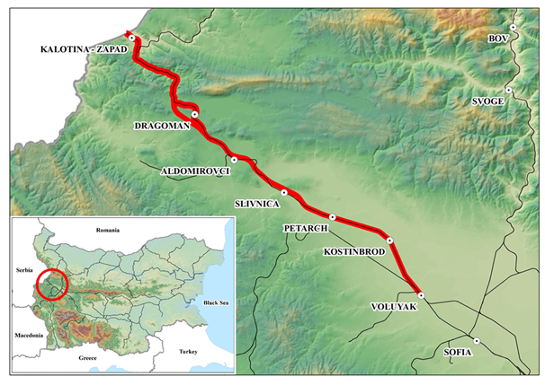
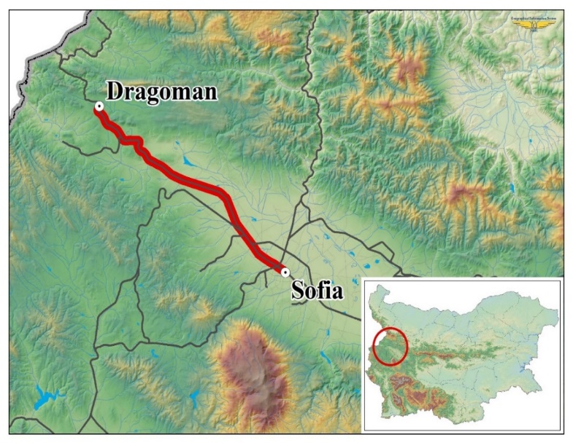
Modernization of the railway line
Voluyak – Dragoman – Serbian border
Part of the “core” TEN-T
Cross-border section
The line can be divided into
two sections:
  Voluyak – Dragoman (35 km);
  Dragoman – border with Republic of Serbia (14, 5 km).
  Indicative value: € 132 M
  Implementation period:
  2022 – 2025

Slide 5
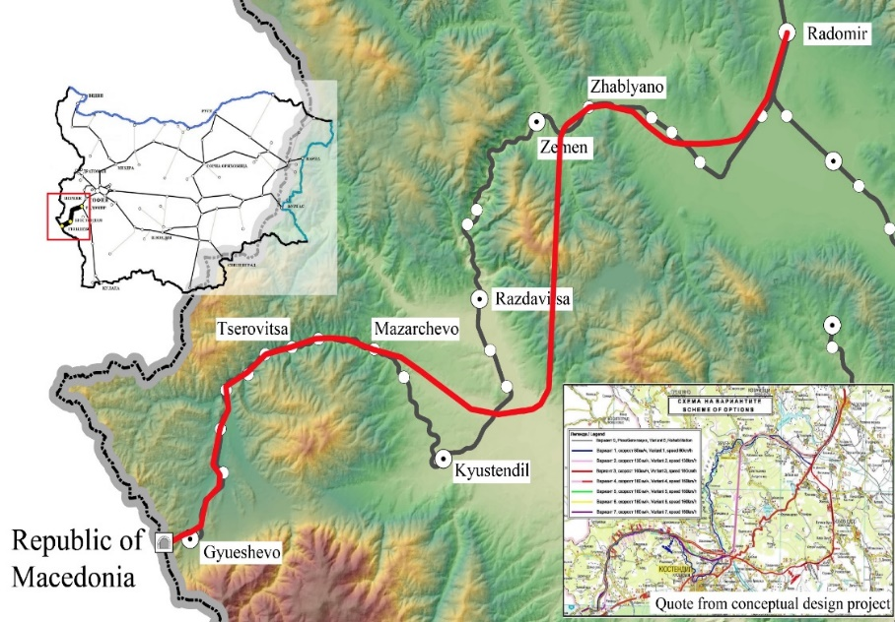
Modernization of the railway line
Radomir – Gyueshevo – Macedonian border
Part of the “core” TEN-T
Cross-border section
The line is divided into
two sections:
  Radomir – Kyustendil (53, 82 km.)
  Kyustendil – Gyueshevo (34,15 km.)
  Gyueshevo - border with the Republic of Macedonia (2 km.)
  Indicative value: € 477 M
  Implementation period: 2022 – 2027

Slide 6
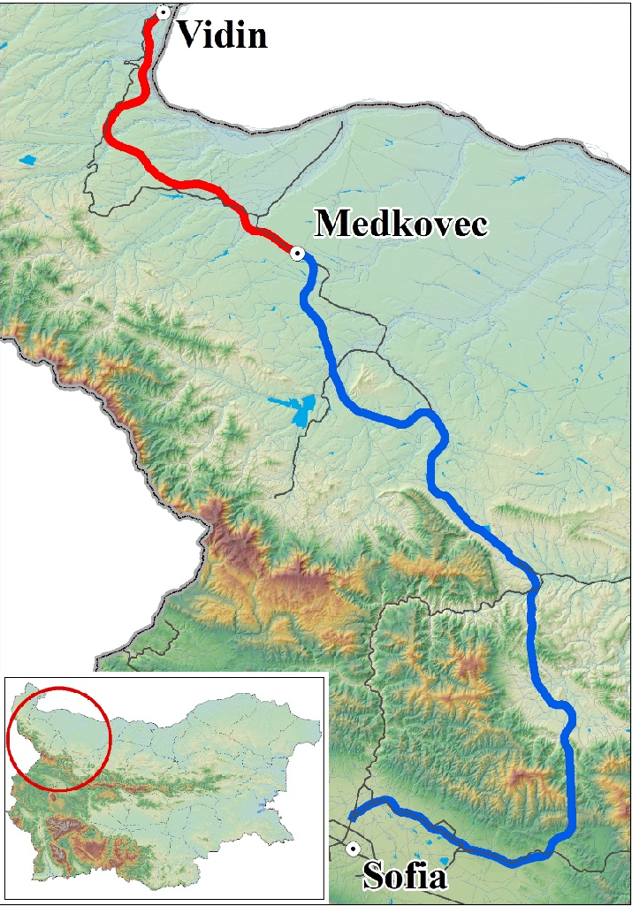
  Modernization of the Vidin – Sofia railway line
Part of Orient/East-Med CNC
Vidin – Medkovec
  Indicative value: € 451 M
  Implementation period: 2022 - 2027
Medkovec – Ruska Byala and
Ruska Byala – Stolnik
  Indicative value: € 1,863 billion
  Implementation period: 2022 - 2034

Slide 7
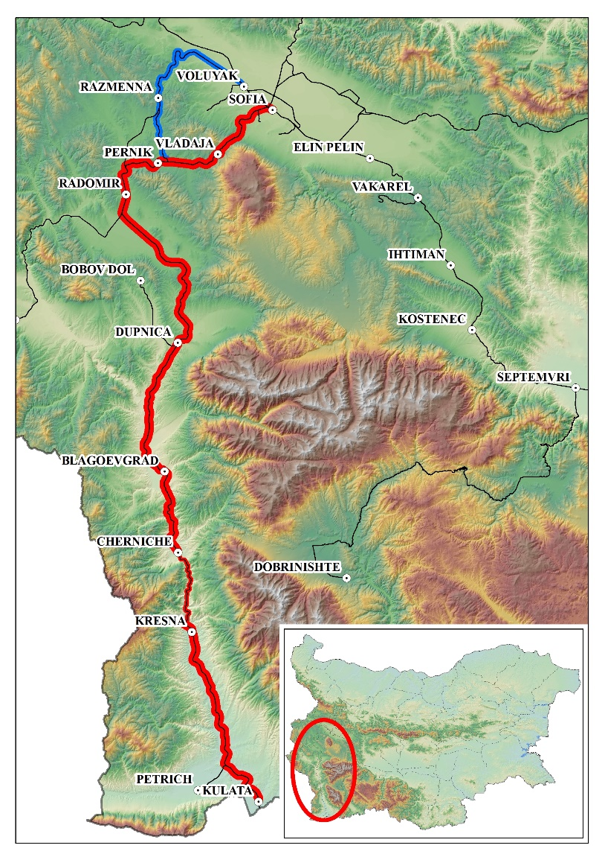
Modernization of the
Sofia – Kulata railway line
Part of Orient/East-Med CNC
Sofia – Pernik
  Indicative value: € 204 M
  Implementation period: 2023 - 2026
Pernik - Radomir
  Indicative value: € 155 M
  Implementation period: 2023 – 2025
Radomir - Kulata
  Indicative value: € 865 M
  Implementation period: 2022 – 2027

Slide 8
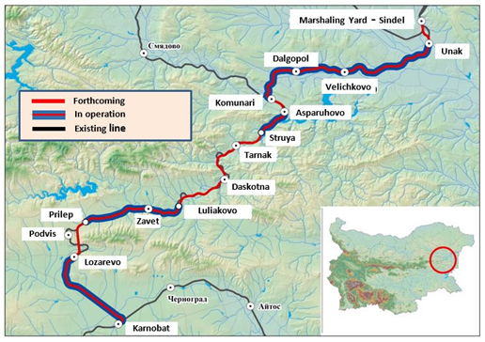
Modernization of the Karnobat – Sindel railway line
Part of the “comprehensive” TEN-T
Connects the two biggest sea ports in Bulgaria: Varna and Burgas
Scope of the project:
  Length: 123 km.
  Axle load: 22,5 t
  Design speed: 130 km/h
  ETCS and GSM-R
Indicative value: € 173 M
Implementation period: 2018 – 2022

Slide 9
Necessary investments until 2030

Slide 10

THANK YOU FOR YOUR ATTENTION!
www.mtitc.government.bg
17 May 2018
Notes:
10

