Slide 1


Open Data Trend Setter
Bulgarian Experience

Slide 2
Europe's Digital Progress Report (EDPR) 2017 Country Profile Bulgaria
Highlight 2017: Open Data Significant progress has been made in the area of Open Data, for which Bulgaria has become a trendsetter in Europe Top 10.
The open data portal (https://opendata.government.bg/) is a central web-based public information system that allows publishing and management of reusable information in an open, machine-readable format.

Slide 3

Bulgarian Open Data Portal
Above 2000 datasets
Above 400 public central and local administrations have profiles
Above 50 public bodies uploaded info up to now
Visualisations on the portal http://viz.opendata.government.bg/
(https://opendata.government.bg/

Slide 4
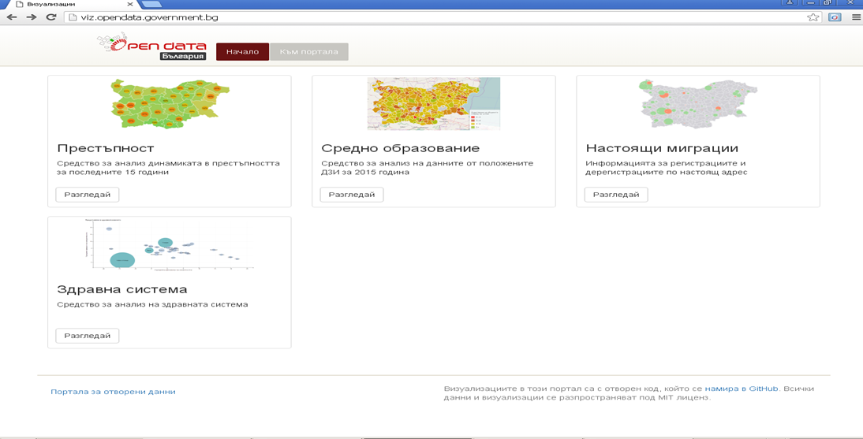
Bulgarian Open Data Portal

Slide 5
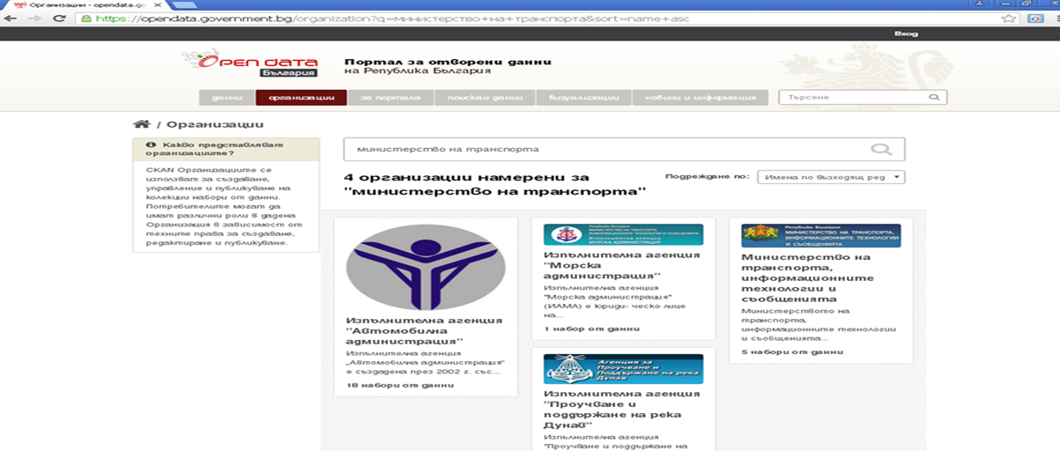
Bulgarian Open Data Portal

Slide 6
European Data Portal

Slide 7
European Data Portal

Slide 8
European Data Portal

Slide 9
European Data Portal

Slide 10

Now is the time to resource and implement open data throughout the world
Sir Tim Berners-Lee, inventor of the World Wide Web.
Open Data Barometer 2017- http://opendatabarometer.org/
A global measure of how governments are publishing and using open data for accountability, innovation and social impact.
On 23 May- Bulgaria participates for the first time

Slide 11
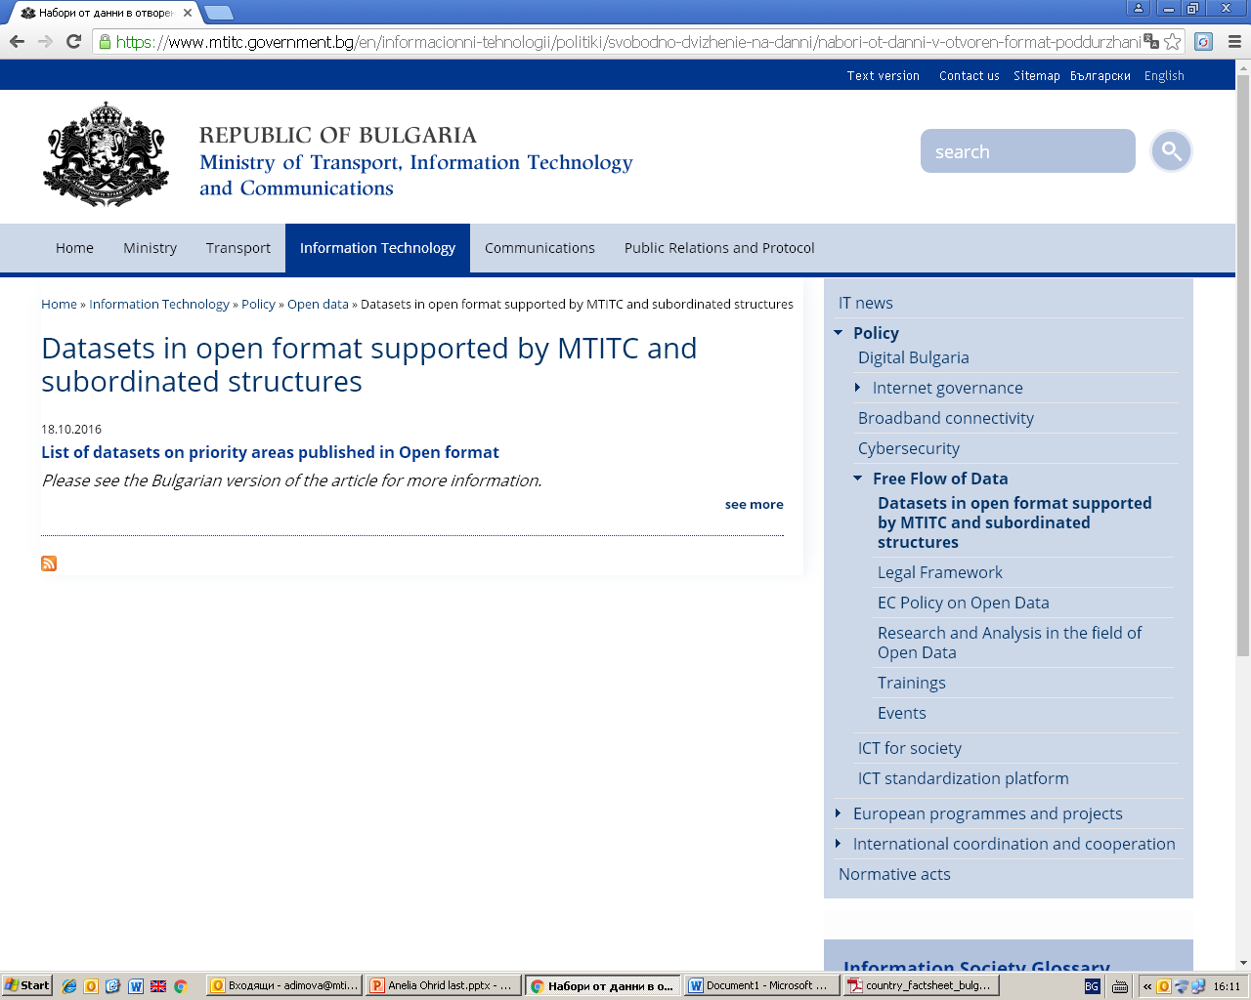
A lot of information on the open data banner on MTITC site:

Slide 12

State e-Government Agency
National contact point for open data in Bulgaria is DATA Department at the Directorate Information Systems and Interoperability in the brand - new State e-Government Agency.The DATA Department functions include organisation, coordination, execution and control of activities on open data issues.
https://www.e-gov.bg/bg/92
https://www.e-gov.bg/bg/96
https://www.e-gov.bg/bg/93

Slide 13

Key word:National Coordination
Be Patient
Good
Things
TAKE TIME

Slide 14

Anelia Dimova: adimova@mtitc.government.bg

