Slide 1
МТИТС - CEF 2019, Sep 5th

Slide 2
About VIVACOM:
VIVACOM has many years of experience in advanced telecommunications solutions at expert level. The company is the largest operator in Bulgaria, offering over 5 million services to its private and business clients. More than 5,000 employees work hard to ensure that over 2 million customers receive the highest quality of service and high-tech next-generation solutions.

Slide 3
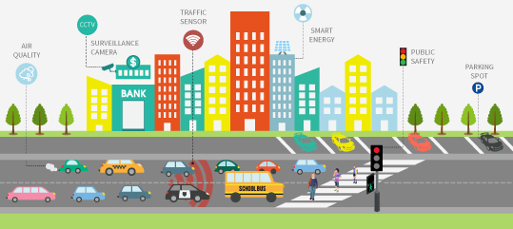
Transport and mobility
Bike sharing
Infrastructure and service for bike sharing
City transport
Automatic Vehicle Location and Fleet Management System
Passenger Information System
Аautomated electronic billing system
E- ticketing
Traffic monitoring
Traffic management and control
Access to real time transportation- data
Smart Parking
Parking occupancy and parking availability

Slide 4
Environment and Energy
Weather stations
Measurement of Air Pollution
Control and access to Air Pollution- data
Waste Management
Data collection and analysis
Optimization of container collection
Real time inventory of waste containers
Street lighting management
Decreasing of electricity consummation

Slide 5
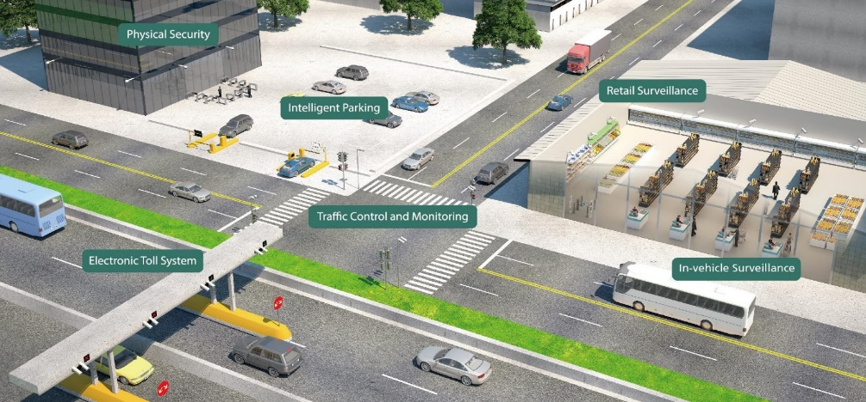
Security
Video Surveillance
Real time data
Control, prevention and security
Traffic control
Traffic regulation
Increasing the efficiency of road infrastructure
Disaster and accident prevention
Monitoring of critical infrastructure /rivers and dams/
Timely signaling to citizens through an appropriate information environment

Slide 6
Services
Municipalities information- mobile apps and web pages
Easy access for citizens to useful information about the Municipality
/web sites, mobile applications, local content/
E- services for citizens
E- Government
E- Municipality
Broadband internet access
Equality of all Municipalities and Municipal Services in their access to appropriate information infrastructure
Public Wi-Fi zones

Slide 7
Smart education
Access to broadband services
Providing the necessary infrastructure
Digital content
Access to diverse content and best practices in education
IT Infrastructure
Cloud infrastructure
Applications
Services

Slide 8
5G deployment

Slide 9
5G expectations
5G - an ultimate game changer for:
Industry digital transformation
One network – multiple industries
Foundation for efficient industries
Mass machine type of communications
Enhanced Customer experience
BB experience everywhere, anytime
10 x faster speeds and 10 x quicker response
Personalized TV viewing
Network Society Building
Smart cities
e-skills and e-services
Cyber security

Slide 10
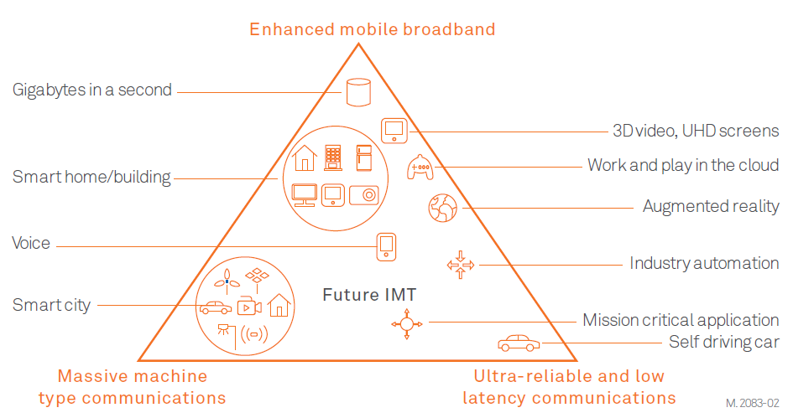
5G usage main scenarios
Enhanced Mobile Broadband (eMBB)
Extension to existing 4G broadband services will be the first commercial 5G set of services to launch
Higher capacity in dense populated areas
Enhanced connectivity – Fix wireless in rural and suburb areas
Increased mobility – mobile broadband services in moving vehicles
Massive Machine Type Communications (mMTC)
Narrowband Internet access for sensing, metering, and monitoring devices
Evolution of the existing eMTC and NB-IoT technologies
Should be able to cope with expected up to 1 million low-power nodes per square kilometer
Ultra-Reliable and Low Latency Communications
Services for latency sensitive applications – third set of commercial 5G services
Factory automation
Autonomous cars
Autonomous public transport
Tele medicine
One of the most innovative aspects of the 5G architecture will be its reliance on 5G network slicing, which will let operators provide portions of their networks for specific customer uses cases — whether that use case is the smart home, the Internet of Things (IoT) factory, the connected car, or the smart energy grid. This will give the ability to deploy only the functions necessary to support particular customers and particular market segments

Slide 11
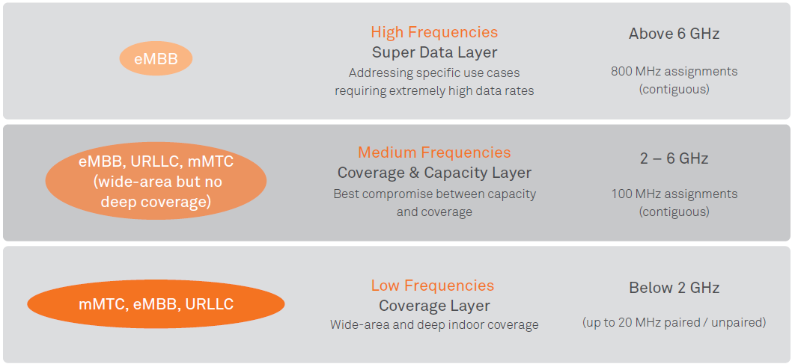
5G spectrum
To address different requirements of 5G usage scenarios, full set of "high", "medium" and "low" frequencies, should be made available by national regulators
24.5-27.5GHz
At least 800MHz per network
5G capacity only
Significant network densification with fiber backhaul
3.4-3.8GHz – C-Band
Major 5G band
At least 100MHz per network
Best balance between coverage and capacity
Network densification with fiber backhaul
700/800/900MHz
700MHz is 5G coverage band with low capacity
800MHz will remain for 4G services and used for 5G in a later stage
900MHz will remain 2G/3G
LTE at 800MHz is very important for voice (5G fallback on VoLTE)

Slide 12
5G deployment challenges
Spectrum should be available and affordable
Coverage – especially rural and roads: 700MHz band
Combination of 5G@700MHz and 4G@800MHz is essential for the deployment of the 5G coverage layer
Main implementation: 3.6GHz band
With other already available LTE bands (e.g. 1800, 2100 and 2600MHz)
EMF regulation and proper communication
New common EU regulation of the EMF standards/calculations is needed
It should be scientifically based and should take into account the specifics of each technology using those bands
Health fears from 5G should be addressed. At the end what EMF could do is function of frequency and radiated power, not the technology
Fast deployment to be possible
Dedicated regulation for building new communication infrastructure and addition of new technologies
Upgrade of existing networks is needed
Densification of the networks is needed
New regulation should be dedicated and relaxed significantly
Public-private partnership for rural and remote areas
Infrastructure and equipment funding with European, state or municipalities resources

Slide 13
Thank you

