Slide 1
CEF Digital
EU infrastructure funding
2021-2027
Regional workshop – Sofia - 5 September 2019
Daniel KITSCHA, Deputy Head of Unit, Unit B5, Investment in High-Capacity Networks, DG CONNECT, European Commission

Slide 2
Financial support for broadband under the next MFF
Structural and Investment Funds (ESIF)
Connecting Europe Facility (CEF) – Digital
InvestEU
  ERDF: broadband investments under priority objective 3, together with transport and energy infrastructure
  EAFRD: broadband investment only as part of local development projects
  EUR 3 bn
  Focus on connectivity infrastructure to enable digital transformation
  Synergies with CEF transport and CEF energy networks within CEF Programme
  Part of Sustainable Infrastructure Window
  11.5 bn guarantee available for broadband investments, but also other infrastructures

Slide 3

CEF DIGITAL 2021-2027 - €3 billion
Alignment with Gigabit Society Strategy objectives: supporting MS in addressing the overall funding gap (€155 bn) with strategic projects
Complementarity with Digital Europe, structural funds & InvestEU
Cross-border 5G automotive corridors (but also railways, inland waterways)
Gigabit connected hospitals, schools, business parks, public Wi-Fi & coverage of surrounding areas (5G communities)
Key international/ cross-border connectivity

Slide 4
Delivery Mechanism
Stronger alignment between policy objectives, specific objectives and eligible actions
Detailed provisions to be set in work programmes, taking into account the prioritisation defined in the Regulation
Close involvement of MS (agreement on [most] projects submitted, adoption of the work programmes and decision on funding to be granted in CEF Committee )
Direct management by the Commission with possibility to delegate to INEA or use indirect management
Technical and administrative assistance for project preparation and capacity building up to 1% of the budget

Slide 5
CEF DIGITAL 2021-2027 - Timeline
Stakeholder Consultations
March/April/May
2019
Consultation on Implementation Roadmap
June – September 2019
First Multiannual Work Programme
End 2020
Commission proposal
June 2018
Political agreement with []
8 March 2019
Consultations in CEF Expert Group
June 2019
Closing MFF negotiations
December 2019

Slide 6
5G corridors along transport paths
Uninterrupted 5G coverage of cross-border sections on pre-agreed (indicative) corridors
5G coverage of other transport paths (rail, inland waterways)
Strategic deployment agenda & cross-sector public - private partnerships
Complementary to Digital Europe and Horizon Europe Programmes

Slide 7
5G corridors along transport paths
Work in progress
Prospective beneficiaries: consortia (5G service providers, passive and active 5G infrastructure and equipment, authorities, etc.)
Open questions:
How to establish market failure in cross-border sections?
Which synergies of public policy objectives & commercial goals?
What options for co-deployment/consortia: Wholesale access, multiple services on one infrastructure, slicing?
What target functionalities and implementation milestones (e.g. coverage, quality and service requirements, timeframe)?
What interest in 5G for rail and inland waterways?
Focus on cross-border sections of politically pre-agreed corridors (up to 50% co-funding rate, e.g. 15-18 mln EUR projects)
Access to roads and spectrum as pre-condition & commitment to intra-MS continuation of service

Slide 8
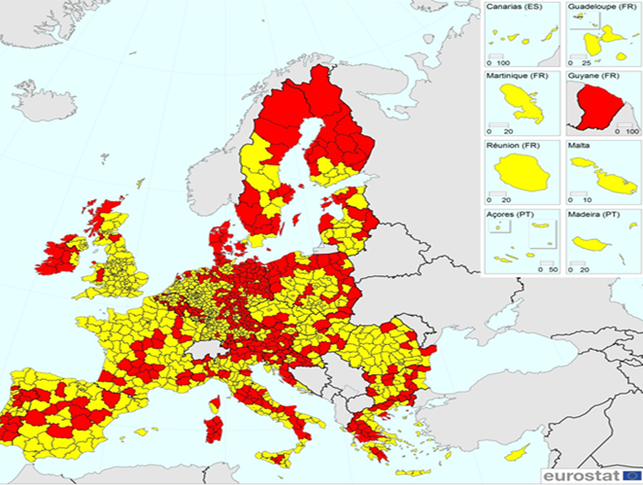
Gigabit connectivity for socio-economic drivers & coverage of surrounding households
VHC (including 5G) connectivity to as many socio-economic drivers as possible
Maximising number of household coverage in the surrounding areas
Creating 5G ready communities
Boost use of online services
Reduce digital divides
Maximising the reach of private investments
Complementarity with Digital Europe Programme
Delineation from structural funds and InvestEU

Slide 9
5G ready communities in Europe
Work in progress
Prospective beneficiaries: VHCN/5G network providers, public authorities, financial intermediaries for blending
Open questions:
What is the interest in stand-alone SED calls?
Are there similar planned ESIF investments (or other public funding programmes), including post 2020?
What is the connectivity gap for (which) SEDs in MS? Vis-à-vis area coverage?
How will MS support building a national project pipeline for later approval of applications?
What 5G use cases should be considered?
Eligibility: non-VHCN areas/SEDs, subject to funding plans including planned ESIF interventions / commercial plans within the next 3 years
Selection criteria:
number of SEDs covered +
resource efficiency (grant needed for coverage generated) +
deploy and operate 5G use cases
Project size:
up to 20 mln EUR for SEDs only,
up to 60 mln EUR for 5G communities,
Max. co-funding rate: up to 75 % for Gigabit to SEDs, 30 % for household VHCN deployments

Slide 10
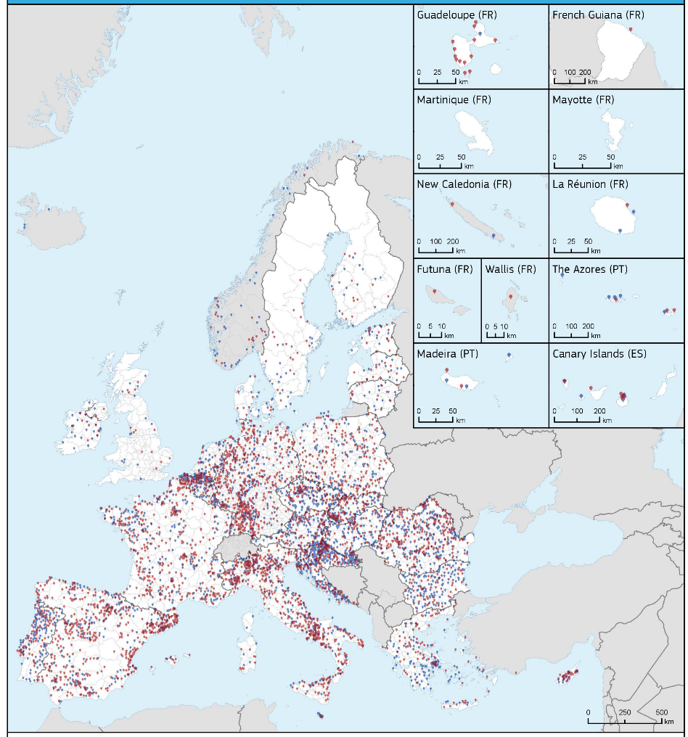
The WiFi4EU voucher programme
Call 1: EUR 42 million
2,800 vouchers awarded
Call launched on November 7, 2018
224 maximum vouchers per country
15 minimum vouchers per country
13,200 applications
3,500 applications in the first 5 seconds
Italy, Germany, Spain, France reached their maximum vouchers within the first seconds
WiFi4EU will give free internet access to local residents and visitors throughout the entire EU in the main centres of community life.
Municipalities and groups of municipalities can apply for EUR 15,000 vouchers assigned on a first-come first-served basis.
Municipalities need to ensure that the internet access is guaranteed for at least 3 years.
WiFi4EU-funded network must be free of charge, free of advertising and free from commercial re-use of data.
Call 2: EUR 51 million
3,400 vouchers awarded
Call launched on April 4, 2019
510 maximum vouchers per country
15 minimum vouchers per country
Close to 10,000 applications
97.5% of available vouchers were claimed in the first 60 seconds
Italy, Germany, Spain, reached their maximum vouchers within the first seconds
Map of awarded municipalities (Call 1 and 2)
Countries such as Bulgaria, Croatia, Ireland, Lithuania, Portugal and Slovenia have more than 50% of their municipalities among the winners of Call 1 or Call 2

Slide 11
Next generation WiFi4EU & 5G Synergy Projects
Work in progress
Next generation “WiFi4EU”
and/or
5G+ communities
Open questions:
Is there continued interest in WiFi4EU deployments?
Interest of cities to deploy and use 5G networks?
Interest to simultaneously use commercial 5G service and free of charge Wi-Fi?
Which smart city 5G use cases should be prioritised?
Potential synergy projects?
Synergies with SED connectivity, Digital Europe Programme (5G vertical use cases)
Synergies within CEF (e.g. for urban transport, smart electricity, etc.)
Possibilities for smart cities, designation of 5G cities according to 5G Action Plan
Simplified grants (vouchers, unit costs) for communities w/o vouchers and/or committing to operate 5g ready small cells
Max. co-funding rate: up to 100 % for small value vouchers; 30 % for small cell deployment

Slide 12
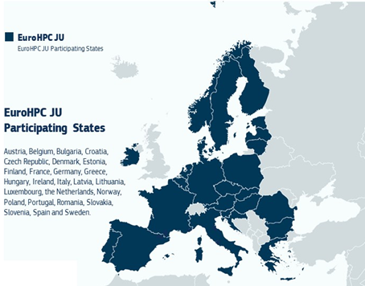
Key international and cross-border HPC connectivity
Terabit links making high performance computing (HPC) available throughout Europe
Increasing capacity & resilience of connections to EU islands or between EU and external hubs
Max. co-funding rate: normal 30%, up to 50% for cross border projects)

Slide 13
Cross-border HPC connectivity
Work in progress
Terabit links making high performance computing (HPC) available throughout Europe
Open Questions:
Which are the best placed beneficiaries in MS to maximise accessibility to HPC capabilities?
How to best link commercial HPC users to the HPC backbone network?
Cooperation / Partners (TBC)
Geant
EuroHPC JU
Network providers
Possible projects: links to e.g. Digital Innovation Hubs; to HPCs (i.e. also commercial connectivity)
Max. co-funding rate: normal 30%, up to 50% for cross border projects)

Slide 14
Key international backbone connectivity
Work in progress
Increasing capacity & resilience of connections to EU islands or between EU and external hubs
Prospective beneficiaries: submarine cable consortia foreseeable, with MS backing
Open Questions:
Concrete MS project proposals?
How to assess contribution to Gigabit objectives?
Estimated capacity needs & funding gap?
What form public support (anchor customer, grant, financial instruments)?
Possible projects: Azores-Madeira-PT, MT- Sicily, FI to Asia (Northeast Passage), Lisbon-Marseille-Milan, etc.
Possible eligibility & selection criteria: market failure, (required) increased capacity and resilience, security, other qualitative connectivity improvements
Max. co-funding rate: normal 30%, up to 50% for cross border projects)

Slide 15
Synergies: Transport – Energy – Digital
Decarbonisation and digitalisation of the Union economy implies a growing need for synergy between transport, energy and digital sectors
"operational digital platforms” which support the flow, storage, processing and analysis of transport and/or energy infrastructure data can be funded under CEF DIGITAL
Possibility to adopt joint work programmes on specific topics (e.g. Connected and Automated Mobility)
The higher co-funding rate of the sectors concerned could be applied, which may in addition be increased by 10%
For each sector synergetic elements pertaining to another sector could be eligible up to 20% of the total eligible cost (e.g. fibre deployment or energy regeneration within a transport project)

Slide 16
Operational Digital Platforms
Work in progress
Definition (Art 2(l))
(l) "operational digital platforms directly associated with transport and energy infrastructure" means physical and virtual information communication technology ("ICT") resources, operating on top of the communication infrastructure, which support the flow, storage, processing and analysis of transport and/or energy infrastructure data;
Eligible actions (Art. 9.4):
(f) actions implementing digital connectivity infrastructure requirements related to cross-border projects in the areas of transport or energy and/or supporting operational digital platforms directly associated to transport or energy infrastructures.
Prioritisation of actions (Art. 8.3.):
(f) with regard to projects deploying operational digital platforms, priority shall be given to actions based on state-of-the-art technologies, taking into account aspects such as interoperability, cybersecurity, data privacy and re-use.
Policy objectives/ KPIs:
Operational digital platform for Connected and Automated Mobility (CAM) services to be available along all EU 5G corridors.
Operational digital platforms for 5G along rail and/or inland waterways

Slide 17

#CEF2digital
Thank you for your interest!
To be continued…
#CEF2digital
Daniel KITSCHA
Deputy Head of Unit
Unit B5 Investment in High-Capacity Networks, DG CONNECT European Commission
daniel.kitscha@ec.europa.eu

Slide 18
Annex

Slide 19
Voluntary transfers of structural funds to CEF Digital
Discussion still open, co-legislators have two different approaches
European Parliament
text of Article 4(9) as voted by ITRE & TRAN on 25/03/2019
Resources allocated to a Member State under shared management may, at its request, and in accordance with the relevant managing Authority be transferred to the Programme, in order for them to be used as part of a blending operation or synergy with other Union programmes action included in a proposal submitted by the Member State concerned and declared eligible by the Commission under a work programme procedure. The Commission shall implement those resources directly in accordance with [point (a) of Article 62(1)] of the Financial Regulation or indirectly in accordance with point (c) of that Article.
Council
text of Article 4(9) and Article 4(10 new) as agreed in COREPER on 13/03/2019
[9. Resources allocated to Member States under shared management may, at their request, be transferred to the Programme. The Commission shall implement those resources directly in accordance with [point (a) of Article 62(1)] of the Financial Regulation or indirectly in accordance with point (c) of that Article. Those resources shall be used for the benefit of the Member State concerned.]
[10. (new) Without prejudice to Article 4 paragraph 9, in the digital sector, resources allocated to Member States under shared management may, at their request, be transferred to the Programme, including to complement the funding of eligible actions under Article 9 paragraph 4 up to 100% of the total eligible cost where possible, without prejudice to the co-financing principle laid in Article 190 of the Financial Regulation and to the State Aid Rules. Those resources shall be used for the benefit of the Member State concerned only. ]

Slide 20
5G corridors along transport paths
Work in progress
Definition (Art. 2(k))
(k) "5G corridor" means a transport path, road, railway or inland waterway, fully covered with digital connectivity infrastructure and in particular 5G systems, enabling the uninterrupted provision of synergy digital services, such as connected and automated mobility, similar smart mobility services for railways or digital connectivity for inland waterways;
Eligible actions (Art. 9.4):
(c) actions implementing uninterrupted coverage with 5G systems of all major transport paths, including the trans-European transport networks;
Prioritisation of actions (Art. 8.3.):
(c) actions contributing to the deployment of 5G corridors along major transport paths, including on the trans-European transport networks, shall be prioritized to ensure coverage along major transport paths, enabling the uninterrupted provision of synergy digital services, taking into account its socio-economic relevance relative to any currently installed technological solutions in a forward looking approach. An indicative list of projects that could benefit from support is included in Part V of the Annex;
Policy objectives / KPIs:
Uninterrupted 5G coverage of cross-border sections (typically 50km each side) on politically agreed 5G corridor map
5G coverage of other transport paths (including rails, inland waters)

Slide 21
5G ready communities in Europe
Work in progress
Definition – (Art. 2(o))
(o) "socio-economic drivers" means entities which by their mission, nature or location can directly or indirectly generate important socio-economic benefits to citizens, business and local communities located in their surrounding territory or in their area of influence;
Eligible actions (Art. 9.4 (a)):
(a) actions supporting the deployment of and access to very high-capacity networks, including 5G systems capable of providing Gigabit connectivity in areas where socioeconomic drivers are located;
Prioritisation of actions (Art. 8.3. (a)):
(a) actions contributing to deployment of and access to very high capacity networks, including 5G and other state-of-the-art connectivity, in line with EU strategic connectivity targets in areas where socioeconomic drivers are located shall be prioritized taking into account their connectivity needs and the additional area coverage generated, including households, in accordance with Part V of the Annex. Stand-alone deployments to socio-economic drivers can be supported except in economically disproportionate or physically impracticable cases.
Policy objectives / KPIs:
5G/Gigabit connectivity to as many SEDs as possible
Maximise number of household VHCN coverage per project (i.e. in areas where SEDs are supported)
Supporting 5G use cases in communities

Slide 22
Next generation WiFi4EU & 5G Synergy Projects
Work in progress
Policy objectives / KPIs:
Option A: Increase number of public WiFi4EU networks (continuation of Wi-Fi router voucher programme)
and/or
Option B: Fund deployment of 5G “smart” cells to support 5G communities applications, but which are also capable to expand the “free of charge” WiFi4EU network in Europe
Eligible actions (Art. 9.4 (b)):
actions supporting the provision of very high-quality local wireless connectivity in local communities that is free of charge and without discriminatory conditions;
Prioritisation of actions (Art. 8.3.):
actions contributing to the provision of very high-quality local wireless connectivity in local communities, in accordance with Part V of the Annex;

Slide 23
Key international and cross-border HPC connectivity (2)
Work in progress
Eligible actions (Art. 9.4(d)):
(d) actions supporting deployment of new or significant upgrade of existing backbone networks including submarine cables, within and between Member States and between the Union and third countries;
Prioritisation of actions (Art. 8.3.(d)):
(d) projects aiming at the deployment or significant upgrade of cross-border backbone networks linking the Union to third countries and reinforcing links between electronic communications networks within the Union territory, including submarine cables, shall be prioritised according to the extent to which they significantly contribute to the increased performance, resilience and very high capacity of those electronic communications networks;
Policy objectives / KPIs:
Ensuring an HPC terabit backbone that reaches all MS
Making HPC computing power commercially available for industry
Increasing backbone capacity/resilience for EU islands/between MS or between the EU and external hubs

Slide 24
CEF Specific Objectives (Article 3)
TRANSPORT
Efficient and interconnected and multi-modal networks
Smart (digital), interoperable, sustainable (e.g. alternative fuels), inclusive, accessible, safe and secure mobility
TEN-T adapted to military mobility requirements
ENERGY
Integration of an efficient and competitive internal energy market
Interoperability of networks across borders & sectors
Decarbonisation of the economy and energy efficiency
Security of supply
Renewables cross-border cooperation
DIGITAL
Deployment of projects of common interest related to safe and secure very high capacity & 5G digital networks
Increased resilience and capacity of backbone networks on EU territories
Digitalisation of transport & energy networks

Slide 25
What will be in the work programme?
As usual:
  Priorities - Eligible actions – Eligible entities
New:
  Multi-Annual Work Programmes
  More flexibility to define:
  Award criteria
  Co-financing rates
  Blending operations
  Specific intervention areas for synergies
  Specifications regarding eligible activities
  Specifications relating to eligible entities
  Approval of the applications by MS may be lifted

Slide 26
What has changed with the awarding process?
Award criteria to be defined in the work programme and calls
To the extent applicable, they should take into account key elements defined in the Basic Act
  e.g. prioritisation of actions by their contribution to digitalisation of communities, by positive spill-overs in terms of coverage of territories surrounding the project deployment areas, by the contribution to increase the resilience and capacity of existing EU networks, etc.
Assessment of the proposals against award criteria shall take into account – where relevant: resilience to the adverse impacts of climate change, synergies etc.

Slide 27
Will CEF be open to the participation of Third Countries?
Consistent approach within the next generation of funding programmes concerning the participation of third countries associated to the Programme: Participation shall be covered by an agreement between the EU and the third country.
Exception: Legal entities established in a third country which is not associated to the Programme are exceptionally eligible if indispensable for the achievement of the objectives of:
  a given project of common interest or;
  a cross-border project in the field of renewable energy

Slide 28
#CEF2digital
Broadband Europe website:
https://ec.europa.eu/digital-single-market/en/broadband-europe
Digital Single Market website:
ec.europa.eu/digital-single-market
2019 – Directorate-General for Communication Networks, Content and Technology

