Slide 1
BCO Bulgaria
4 September 2019

Slide 2
The Connectivity
Objectives
DSM targets for 2020:
30 Mbps or more for all citizens
100 Mbps or more by 50% of households
Gigabit Society targets for 2025:
1 Gbps for all schools, transport hubs and main providers of public services and digitally intensive enterprises
100 Mbps to be upgraded to 1 Gbps for all European households
5G wireless broadband coverage
76% EU citizens
NGA connected,
BUT only 40% in rural areas.
Market failure due to lack of business case in some areas.
Intervention needed
on selective basis.
Notes:
Met with three DGs’ Comms units individually
Planning meeting with all three together

Slide 3
The BCO
Initiative
The European Commission called on Member States to create a network of Broadband Competence Offices to address these issues.
Indeed some of the hurdles seem recurrent:
Regulatory
Technical
Finance

Slide 4
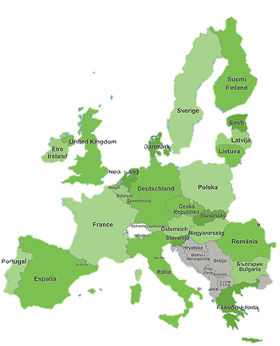
The BCO
Network
A 28 EU Member States Network to:
Share good practices
Learn from each other
Develop common tools and resources
Build competence
At national and regional level
Accelerate uptake
of public funds for broadband

Slide 5
Objectives:
Reinforcing the BCO Network’s membership and identity; increasing BCOs’ ownership of the Network
Identifying potential measures to enhance BCOs’ technical and coordination capacity
Promoting the creations of BCOs at regional level
Disseminating knowledge, including the exchange of good practices
Identification of potential multipliers involved in the implementation of broadband plans in Europe

Slide 6
Thematic priorities for 2020:
Mapping
5G
Investment models in rural areas, building up on the actions implemented under the “Rural Broadband Action Plan”
EU financing for broadband in the future MFF

Slide 7
Good practices
Check-out:
the database of good practices in broadband projects
the European Broadband Awards archive
the BCO Network video interview series on good practices in broadband projects
the Broadband Europe portal and newsletter

Slide 8
Good practices in your country?
Want to propose a project to be included as a good practice in the database?
→ Contact us by email on info@broadbandeurope.eu to propose a project to be included in the database of good practices in broadband projects.

Slide 9
Upcoming events in 2019:
BCO Network Annual Conference on 26 September in Brussels
Ensuring Future Dynamic Rural Areas during the European Week of Regions and Cities on 8 October in Brussels
Mapping and Investment Models for Rural Areas on 22-23 October in Brussels
Ensuring Future Dynamic Rural Areas
8 October 2019, Brussels
14:30-16:00
How to register?
1. Go to the session page
2. Click log in (using your EU Login details)
3. If requested, complete your profile
4. Once your profile is complete, click on the now-activated “Add session” button
5. Your registration will be confirmed by email within a week

Slide 10
Brochures
A series of publications supporting broadband roll-out in Europe

Slide 11
A brochure on European funding for broadband in the Western Balkans
The brochure offers an overview of the main sources of funding and targets public administrations and private promoters involved in the development of digital connectivity in the region

Slide 12
Website:
www.bconetwork.eu
BCO Network forum (Futurium): www.forum.bconetwork.eu

Slide 13
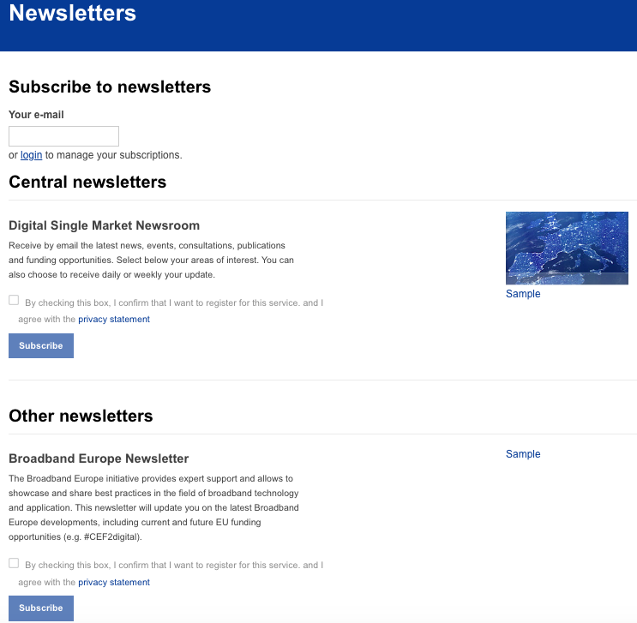
Newsletters:
Subscribe here:
https://ec.europa.eu/digital-single-market/en/newsletters

Slide 14
Contacts:
Tel: +32 (0) 2 282 09 18
Email: info@broadbandeurope.eu
Notes:
Met with three DGs’ Comms units individually
Planning meeting with all three together

