Slide 1

Preparing and sharing data with the
ELRC-SHARE repository and what happens next
Maria Giagkou
Institute for Language and Speech Processing / Athena R.C.
ELRC

Slide 2
The notion of data
Demographic
Public spending
Educational
Geospatial
Weather / climate
Public health and insurance

Slide 3

The notion of data
Data: the oil of the 21st century

Slide 4


The notion of data

Slide 5
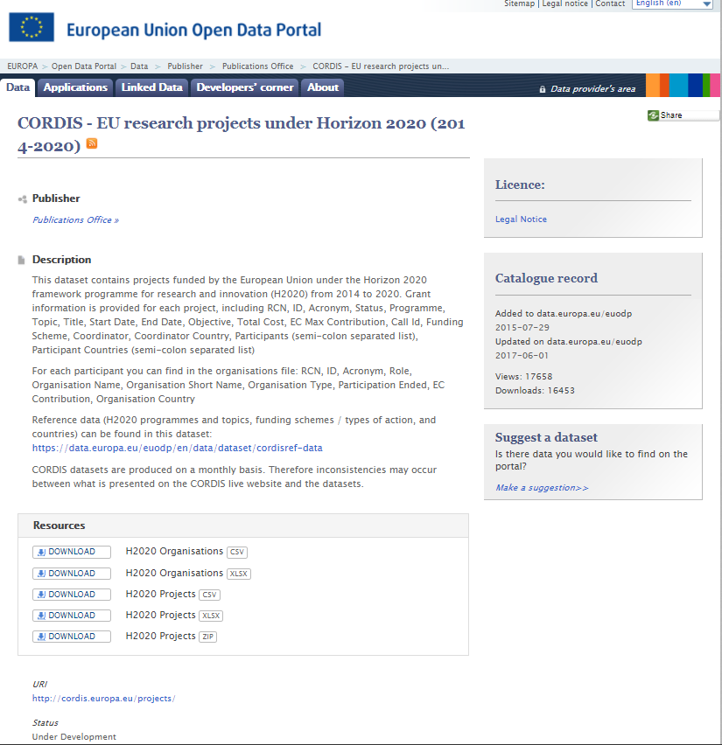
The notion of data
Basic concepts:
Data: any piece of electronically stored content
Dataset (or resource): the collection of one or many data files grouped according to certain criteria
Metadata: data about the data, i.e. description of a dataset with properties (e.g. title, publisher, description of the content and URL)

Slide 6
The notion of language data
Data
(Textual) Language Data
  any piece of electronically stored content
any piece of electronically stored text

Slide 7
Language data for eTranslation
BG
EN
  Ако не е осигурена взаимност, може да бъде отказано разрешение за двустранен превоз по редовна линия.
  Смесената комисия, създадена в съответствие с член 15, решава какъв вид трябва да има формата на искането за разрешение, реда за съгласуване, както и изискващите се придружаващи документи.
If there is no reciprocity, an authorization for a bilateral regular service can be refused.
The Joint Committee set up under Article 15 hereof decides on the form on the authorization application, the procedure agreement and the supporting documents required.

Slide 8








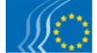
Data used by eTranslation
DGT translation memory

Slide 9
Such data are already available
BUT they are not enough…

Slide 10
What data are useful for eTranslation as per type |1
Any electronically stored text in an EU language plus NO and IS
Texts and their translations (i.e. parallel bilingual or multilingual)
Bulgarian text
Translation in English
1. Компетентните органи на двете Договарящи страни си разменят всяка година договорен определен брой разрешителни.
2. Разрешителните се издават на местните превозвачи от компетентния орган или от организация, определена от споменатия орган.
3. Разрешителните се издават на името на превозвача и не се използват или преотстъпват на други превозвачи.
4. Разрешителните могат да бъдат използвани за едно превозно средство за определения срок.
Разрешителните са валидни до 31 януари на следващата календарна година.
1. The competent authorities of the two Contracting Parties exchange and agree number of blank permit forms every year.
2. Permits are issued to resident transport operators by the competent authority or by a body designated by the said authority.
3. Permits are personal and are not transferable to third parties.
4. Permits can only be used for one vehicle at a time.
The permits shall be valid until 31 January of the successive calendar year.

Slide 11
What data are useful for eTranslation as per type |2
List of terms and their translations, i.e. a terminology
Bulgarian | English
счетоводство | accountancy
счетоводен баланс | accounting balance
счетоводна конвенция | accounting convention
акредитация | accreditation
счетоводен принцип на начисляване | accrual accounting concept
основа за начисляване | accrual basis
начислени разходи | accrued expenses
цена за придобиване | acquisition cost
искове за отмяна | actions of repeal
активен капитал | active capital
… | …

Slide 12






What data are useful for eTranslation as per format |1
In principle, any text in machine readable format
But, some formats are more “MT-ready” than others, i.e. they require less manual or automatic processing
More processing introduces more errors in the final output, making it less useful for eTranslation

Slide 13
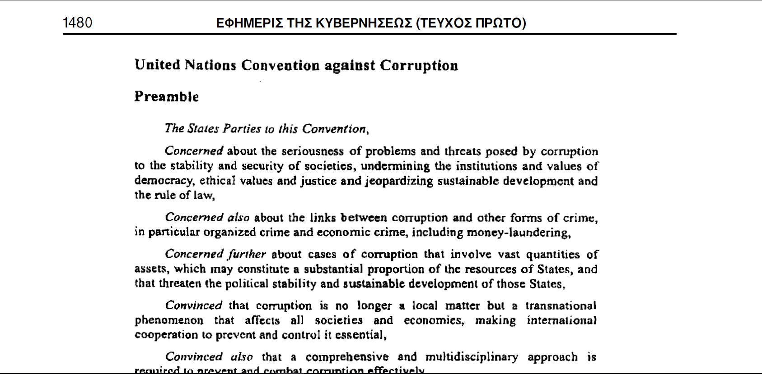
File formats for parallel texts

Slide 14
What data are useful for eTranslation as per format |2
The following formats are particularly useful (in descending order):
  For bilingual/multilingual parallel texts
    Translation memories (.tmx)
    XML translation files (.xliff)
    Plain text (.txt, .csv)
    Spreadsheets (e.g. xlsx)
  For terminologies
    TermBase eXchange (.tbx)
    Plain text (.txt, .csv)
    Spreadsheets (e.g. xlsx)
  For monolingual texts
  Plain text (.txt, .csv)

Slide 15
File formats of parallel texts and their manipulation

Slide 16

Preparing your data |1
Don’ts
This is a paragraph in English. This is a paragraph in English. This is a paragraph in English. This is a paragraph in English. This is a paragraph in English. This is a paragraph in English. This is a paragraph in English. This is a paragraph in English. This is a paragraph in English. This is a paragraph in English. This is a paragraph in English.
Това е българският превод на параграфа по-горе. Това е българският превод на параграфа по-горе. Това е българският превод на параграфа по-горе. Това е българският превод на параграфа по-горе. Това е българският превод на параграфа по-горе.
A second paragraph in English. A second paragraph in English. A second paragraph in English. A second paragraph in English. A second paragraph in English. A second paragraph in English. A second paragraph in English.
Това е българският превод на параграфа по-горе. Това е българският превод на параграфа по-горе. Това е българският превод на параграфа по-горе. Това е българският превод на параграфа по-горе.

Slide 17
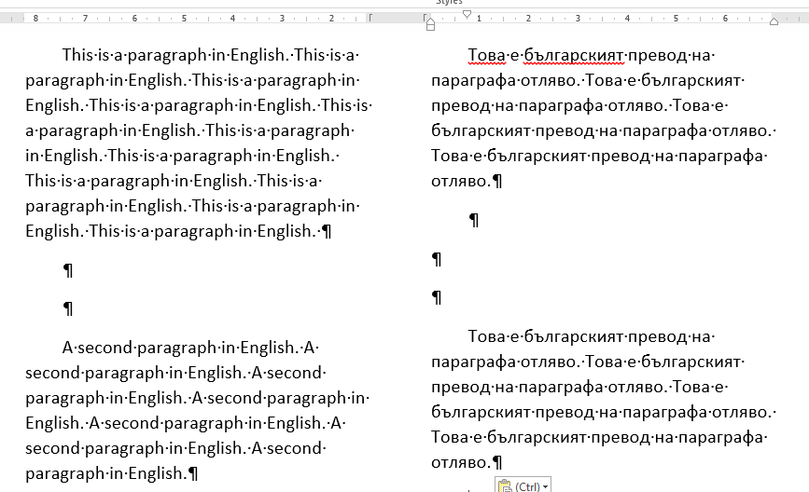
Preparing your data |2
Don’ts

Slide 18
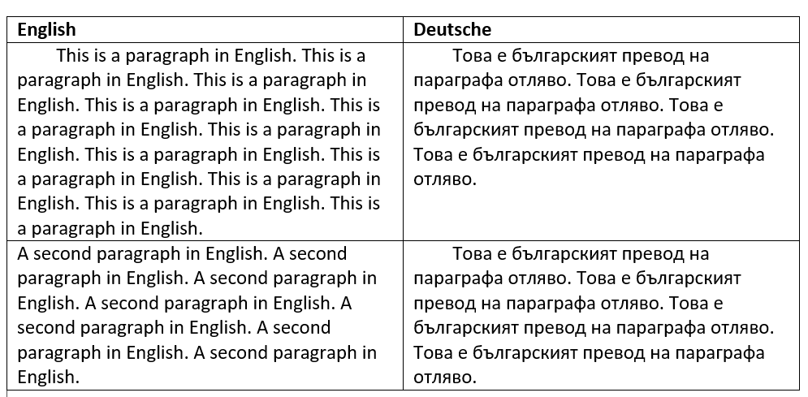
Preparing your data |3
Don’ts

Slide 19


Preparing your data |4
Do’s
Use identical filenames for each document pair (source – translation)

Slide 20
Preparing your data |5
Do’s
Include language identifiers in the filename

Slide 21
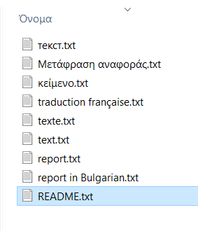
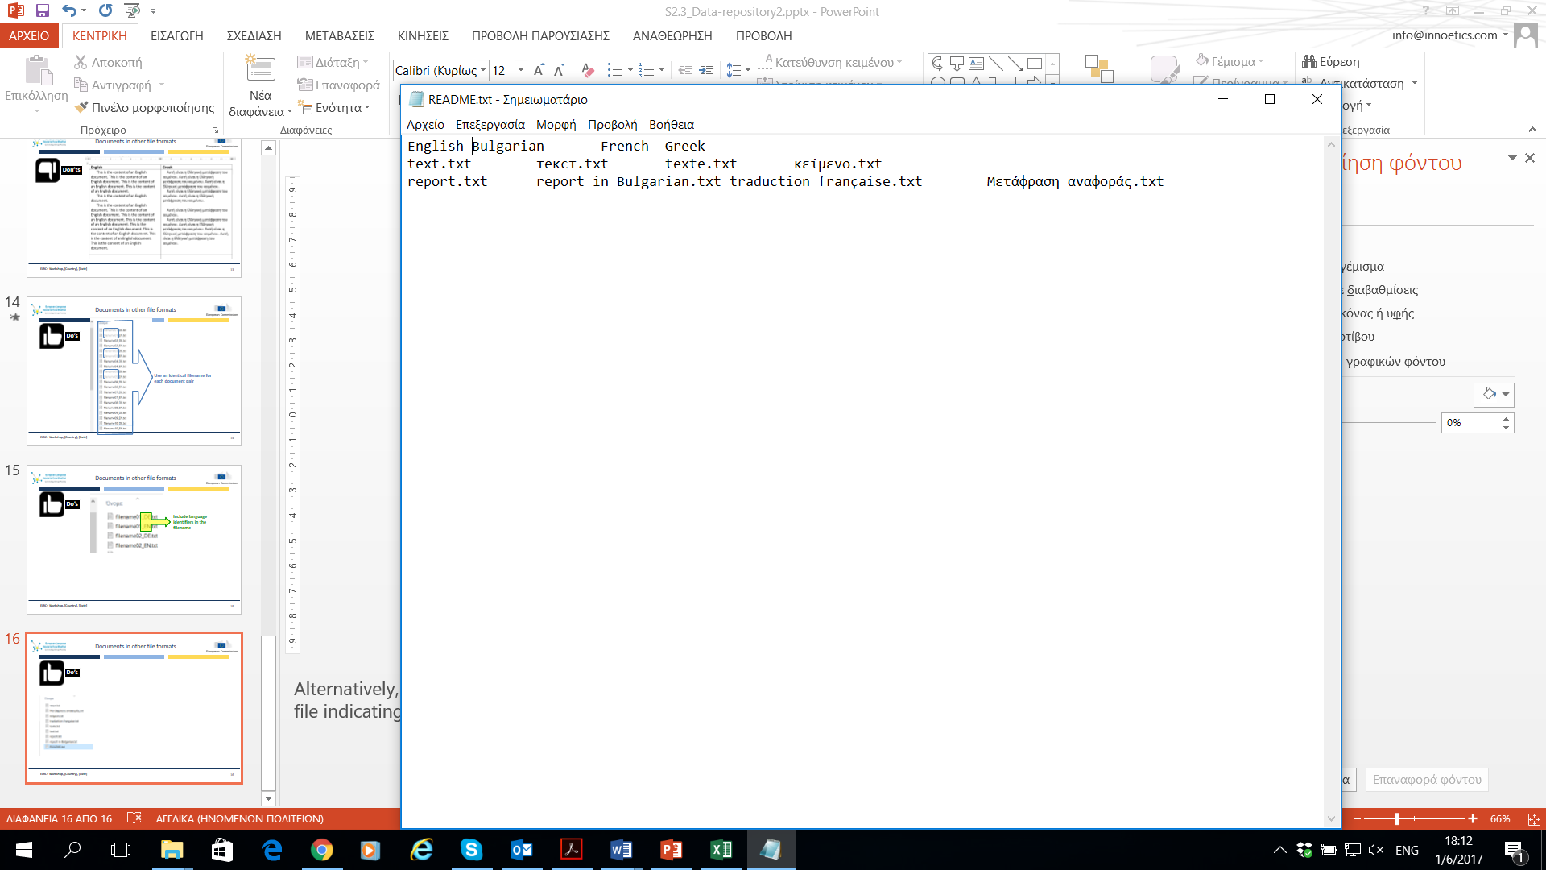
Preparing your data |5
Do’s

Slide 22
Criteria for grouping your data
Remember: a dataset is a collection of data grouped according to certain criteria
For the purpose of enhancing and adapting CEF eTranslation, two criteria are critical:
  Language(s): each collection is defined by the language or language pairs of its data, e.g.
    Collection of texts in English – Bulgarian
    Documents in English – Bulgarian - French
  Domain: each collection ideally belongs to a single domain, e.g.
    Collection of texts in English – Bulgarian in the culture domain
    Social security documents in English – Bulgarian - French

Slide 23
Preferred domains
Administrative/regulatory domain and
Topics relevant to the CEF DSIs
CEF DSI | Domain
Online Dispute Resolution | Consumers’ rights, complaints
Electronic Exchange of Social Security Information | Social security, insurance
eProcurement | Public procurement, contractual agreements
European e-Justice Portal | Justice, Law
eHealth | Health, Medicine
Business Registers Interconnection System | Business, market
Safer Internet
Cybersecurity
Public Open Data
Europeana | Culture

Slide 24
How to contribute your data to CEF eTranslation
A step-by-step guide

Slide 25
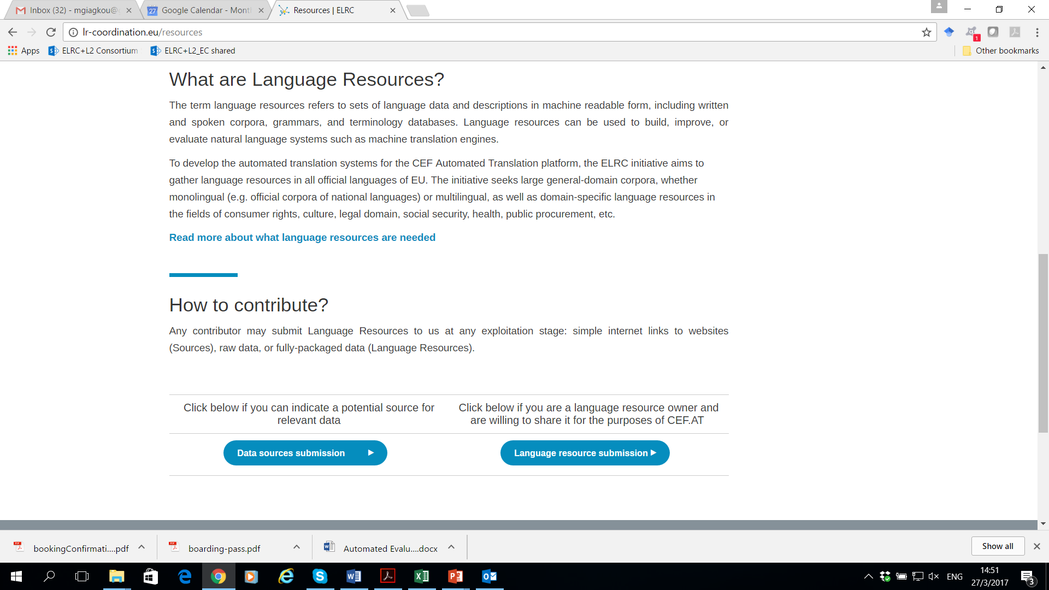
To ELRC-SHARE
At the ELRC portal click on the “Language resource submission” button
Or
Type in the url address:
elrc-share.eu

Slide 26

ELRC-SHARE repository

Slide 27
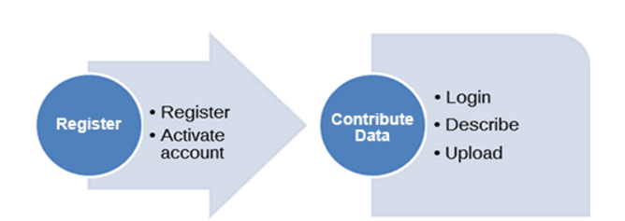
How to Contribute Data

Slide 28

How to Register (1/2)

Slide 29
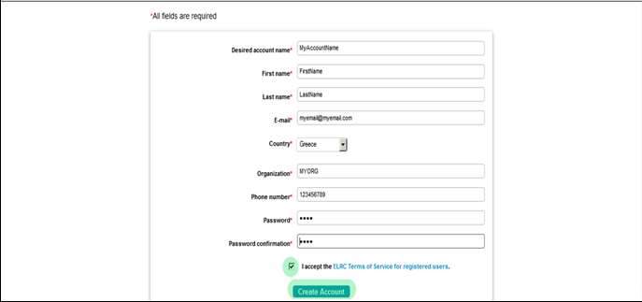
How to Register (2/2)
Fill in the required info
Read the Terms of Service and click Accept, if you agree
Click the Create Account button
Activate your account according to the guidelines emailed to you

Slide 30

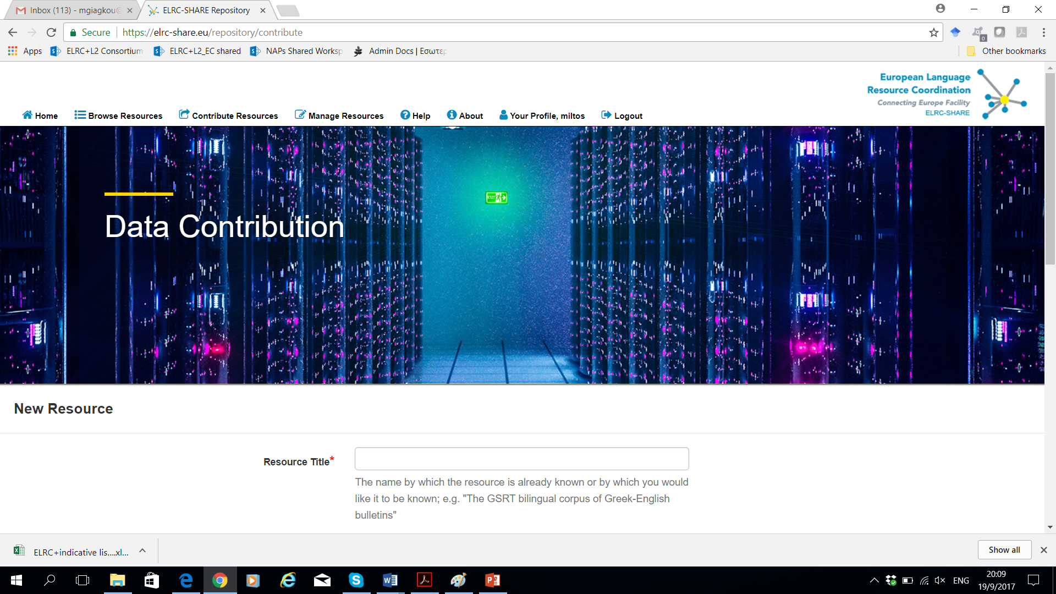
How to Contribute Data (1/6)

Slide 31
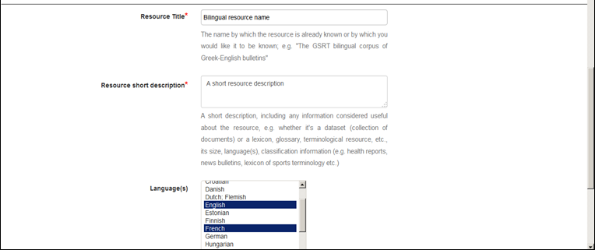
How to Contribute Data (2/6)
Fill in the details of the dataset

Slide 32
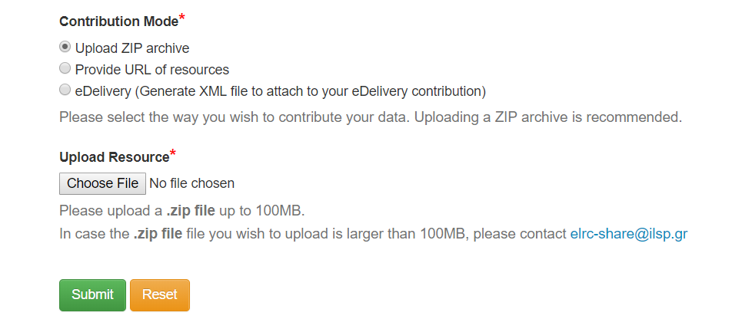
How to Contribute Data (3/6)
Three modes for contributing your data

Slide 33
How to create a .zip file
Free file compression tools (indicative):
  7zip
  PeaZip
  Hamster Free Zip Archiver
  Universal Extractor
  ZipItFree
Windows embedded compression functionality

Slide 34
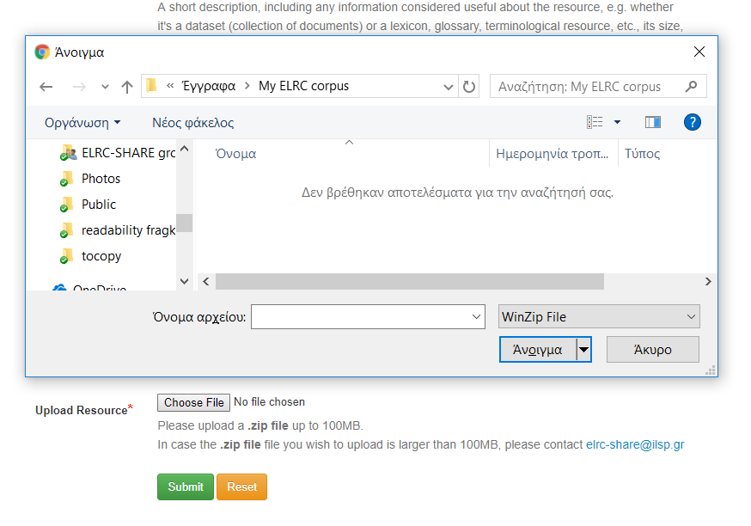
How to Contribute Data (4/6)
Click on Choose file
Locate your resource in your hard disk
Click on Submit
2
1
3

Slide 35
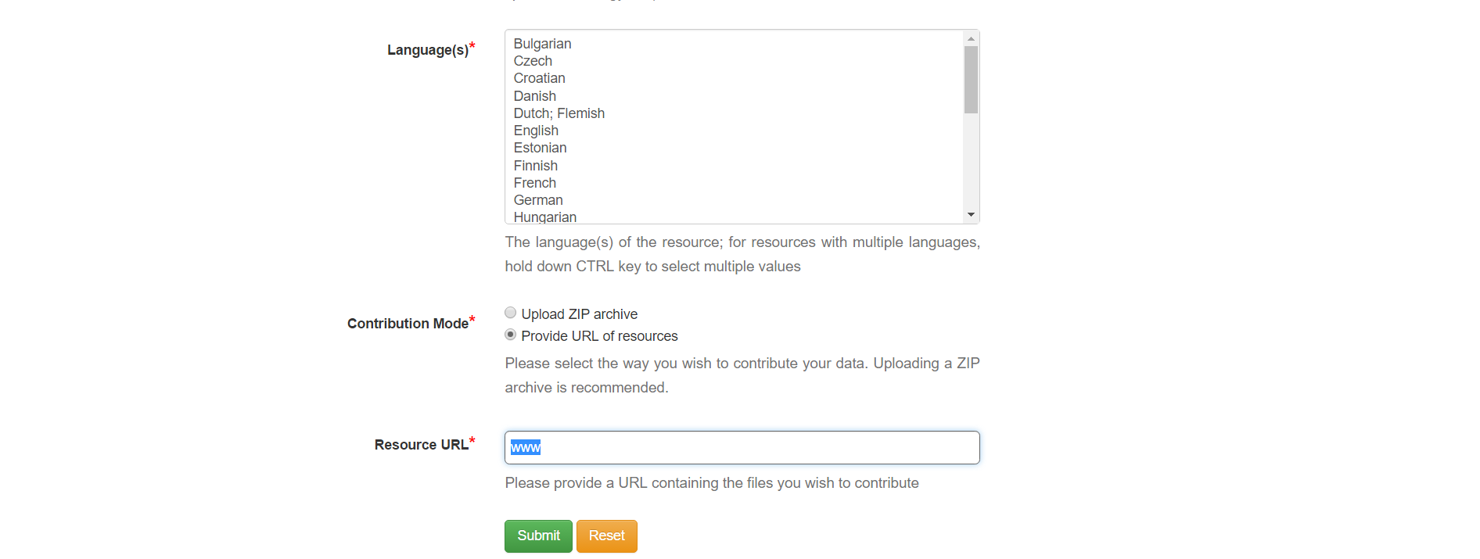
How to Contribute Data (5/6)
Alternatively indicate a url (directory listing)

Slide 36
How to Contribute Data (6/6)
Repeat the process if you want to contribute another resource, or log out

Slide 37

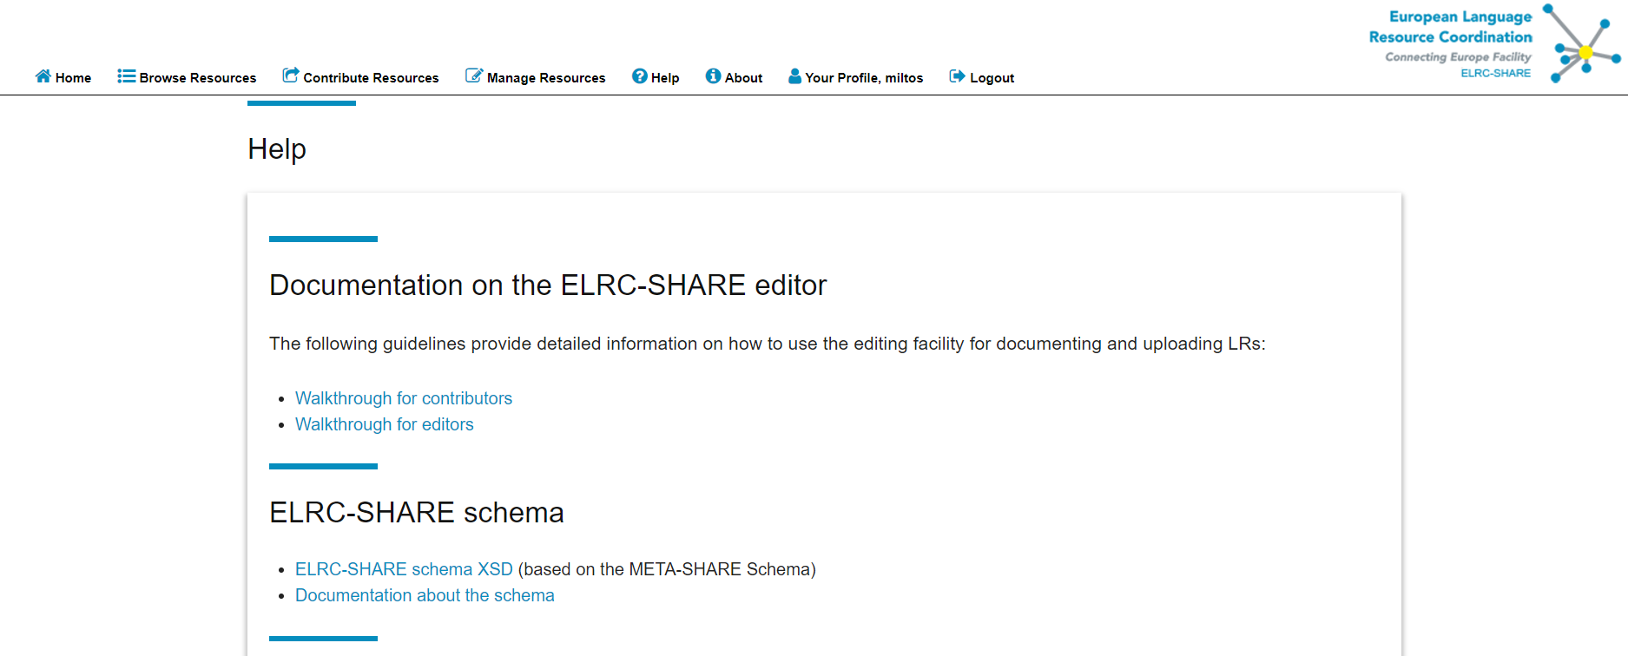
Guidelines for contributors

Slide 38
What happens next?

Slide 39






What happens to your data?
ELRC processes your data
Processed data
Upload to ELRC-SHARE
Data contributor

Slide 40



Language processing services
Data extraction
Anonymisation
Cleaning
Re-formatting
If your data is trapped in archives and databases, we can help extract it
Does your data contain private info? We can help to anonymise
If your data is messy (i.e., lots of noise), we will clean it up
Need to re-format DOCX to XML, or PDF to WORD? Let us do it for you!

Slide 41




Language processing services
Data conversion
Tag removal
Alignment
Metadata
If your data isn’t converted to the proper formats, we can help convert it
Does your data contain unneeded tags? We can assist in removing them!
Translations aren’t aligned? We’ll do it for you with our tools!
Metadata are crucial! We can organise and validate metadata for your team

Slide 42
What has happened to your data?
File01_bg.txt
File01_en.doc
File02_bg.pdf
File02_en.txt
File03_bg.doc
File03_en.doc
…
<tu tuid="20">
<tuv xml:lang="bg">
<seg> ''Страна на регистрация'' означава територията на Договарящата страна, в която са регистрирани превозвачът и превозното средство.</seg>
</tuv>
<tuv xml:lang="en">
<seg> “Country of establishment” means the territory of a Contracting Party within which the transport operator is established and the vehicle registered.</seg>
</tuv>
</tu>
<tu tuid="21">
<tuv xml:lang="bg">
<seg> ''Пътнически превоз по редовна линия'' означава превозна услуга, при която се превозват пътници по определени маршрути, разписание и установени цени.</seg>
</tuv>
<tuv xml:lang="en">
<seg> “Regular passenger service” means a service which carries passengers over a specified route, according to a timetable and for which set fares are charged.</seg>
</tuv>
</tu>
After processing

Slide 43
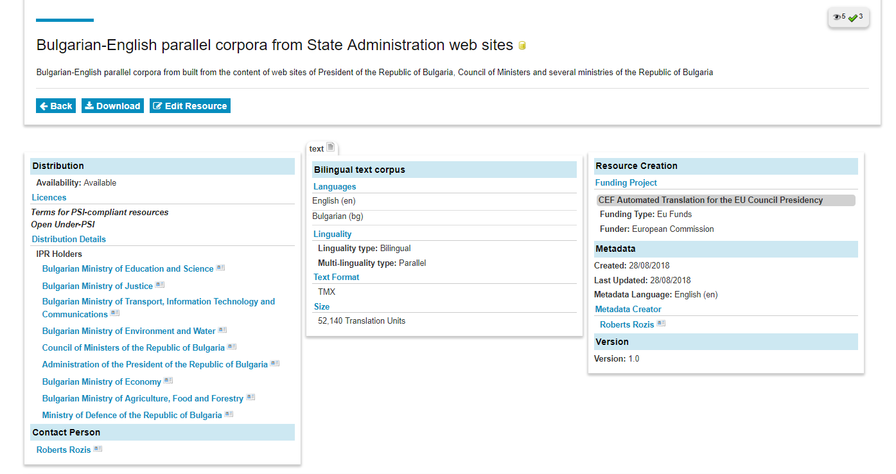
The notion of data in the context of eTranslation

Slide 44

On-site assistance
All these services can also be offered on-site to all data contributors free of charge

Slide 45

On-site assistance
Our team of experts will travel directly to assist you
at your own offices

Slide 46
On-site assistance
We will fix your data issues and return the processed data directly to you. We can also help to improve your data management processes. Just ask!

Slide 47

What happens to your data?
ELRC processes your data
Processed data
Upload to ELRC-SHARE
Data contributor
Request on-site assistance

Slide 48
How to request services and help

Slide 49
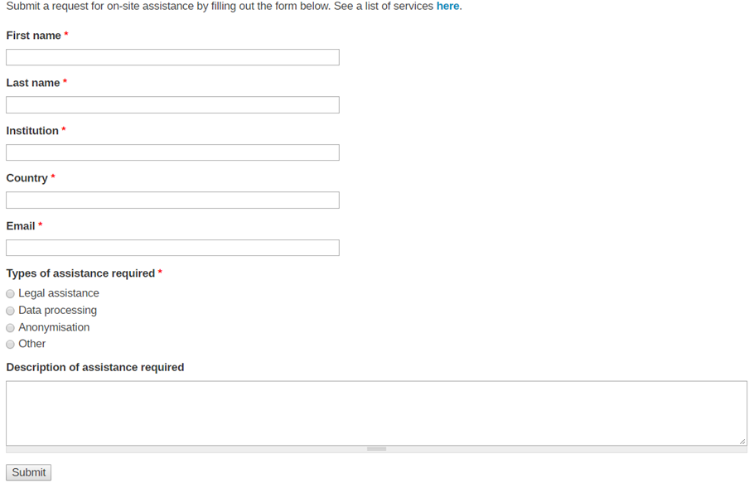
ELRC onsite assistance
lr-coordination.eu/request-onsite-assistance

Slide 50

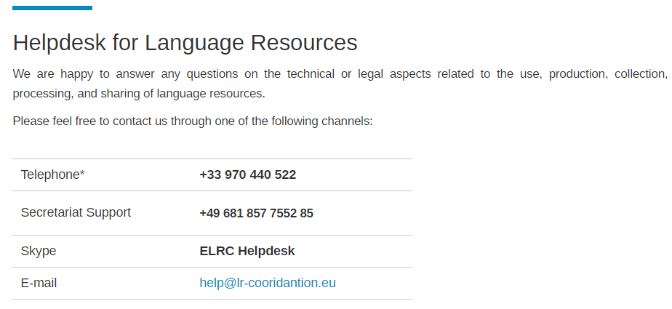
ELRC Helpdesk
lr-coordination.eu/helpdesk

Slide 51
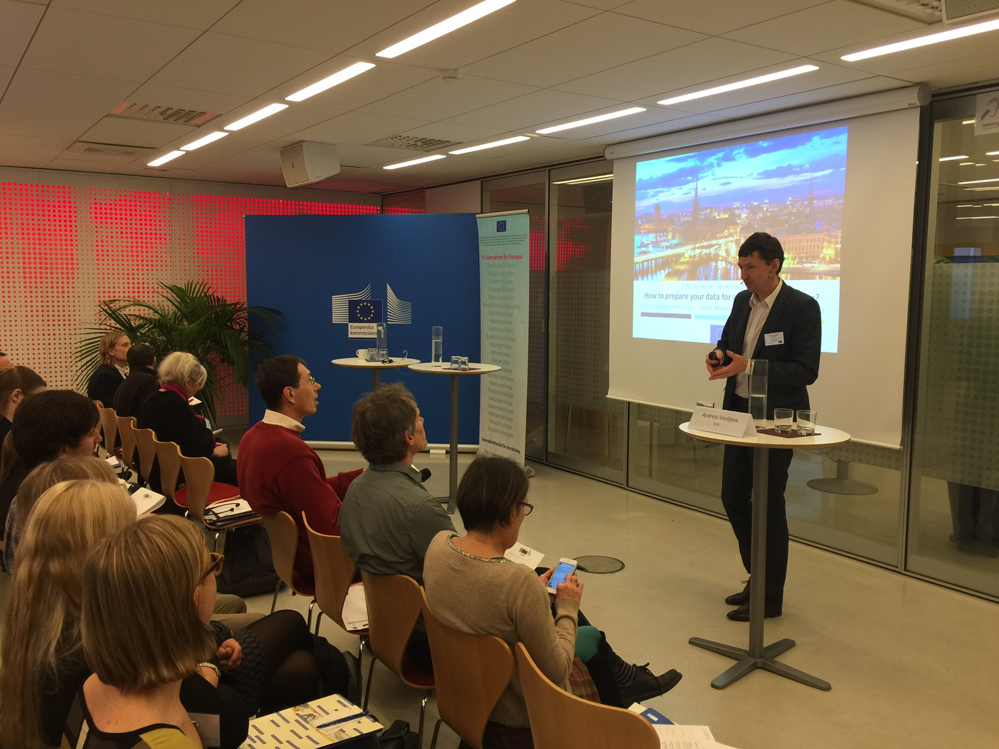
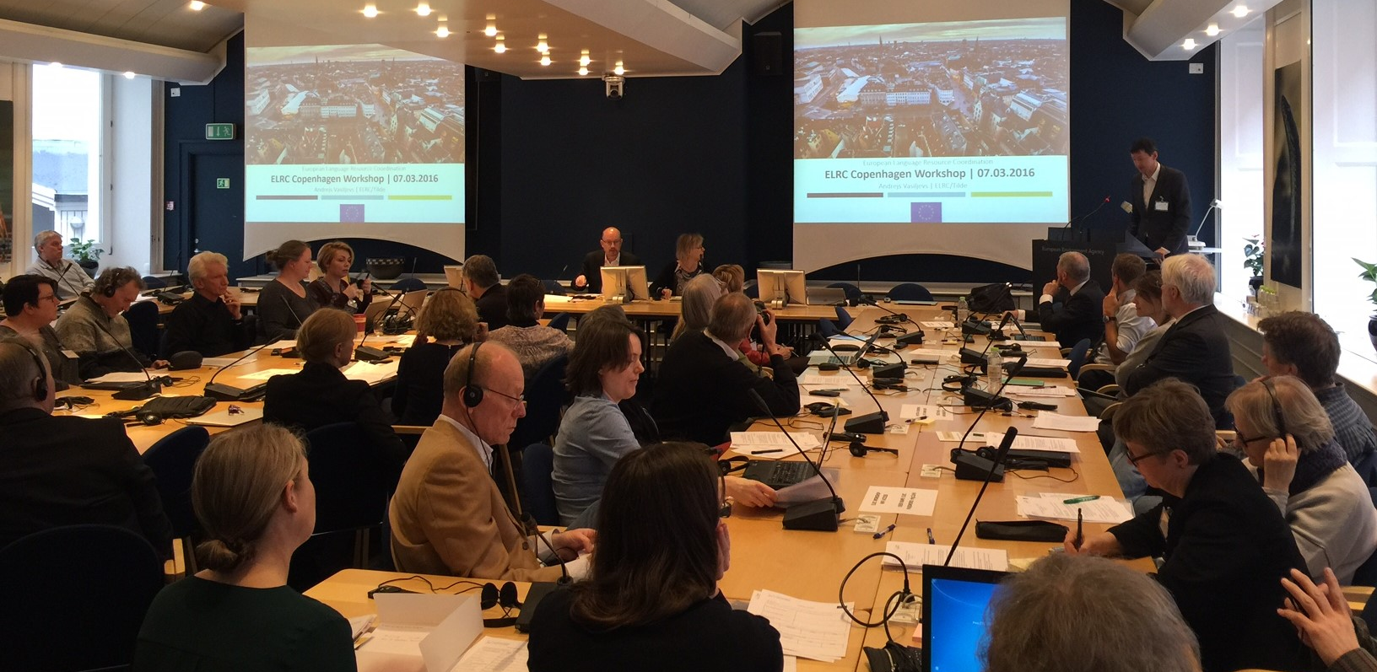




ELRC consortium – come talk to us!

Slide 52

Благодаря ви!

Slide 53
Icons used in this presentation
By Michael Mellon, GB, , CC-BY 3.0 US
By Joana Pereira, BR, CC-BY 3.0 US
By Becca O'Shea, NZ, CC-BY 3.0 US
By Creative Stall, Basic licence www.iconfinder.com
By Creative Stall, PK, CC-BY 3.0 US
By Arthur Shlain, IL, CC-BY 3.0 US
By Shmidt Sergey, US, CC-BY 3.0 US
By Gregor Cresnar, CC-BY 3.0 US
By anbileru adaleru, CC-BY 3.0 US
By Vectors Market, CC-BY 3.0 US

Slide 54
Case studies (2015-2016)

Slide 55

Spain
Problem: Data provider didn’t store translations as related documents, therefore source/target translation weren’t paired
Solution: ELRC helped crawl a local system to find, related, and pair source/target translations

Slide 56
Spain
Problem: In some Spanish governmental departments, archives were only available in PDF
Solution: ELRC helped provide good converters to get usable documents

Slide 57

Germany
Problem: Data owner needed help with anonymization, as databases contained personal info. Another need: cleaning up ‘junk’ data (URLs, numbers, fragments)
Solution: ELRC helped provide anonymization services and data cleaning

Slide 58

Estonia
Problem: Data donor found that legal acts in EN, ET, RU couldn’t be aligned on a document level (no common machine-readable cross-language ID)
Solution: ELRC helped provide alignment services for documents

